Slide 1

CMPT 413/713: Natural Language Processing
Neural Network Basics
Zhiyun (Richard) Peng
2026-09-25
Adapted from slides from Angel Chang, Anoop Sarkar, Danqi Chen and Karthik Narasimhan
Notes:
http://demo.clab.cs.cmu.edu/NLP/

Slide 2
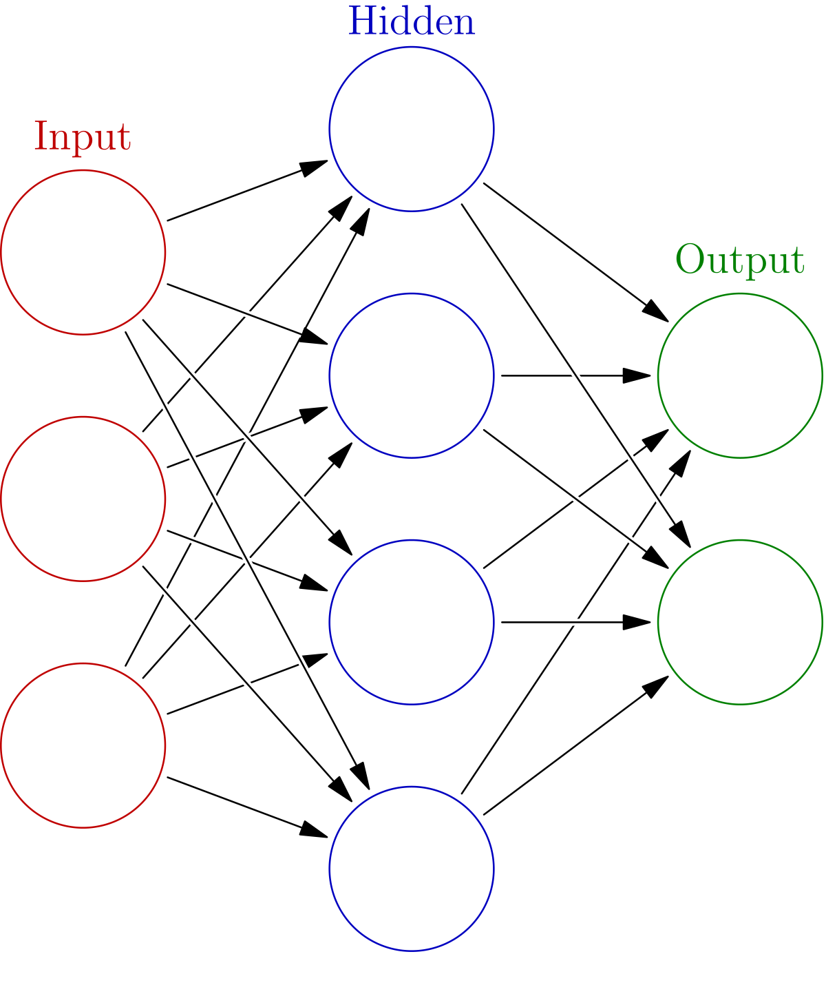
Types of supervised classifiers
Naive Bayes
Logistic regression
Neural networks
Support vector machines
k-nearest neighbors

Slide 3


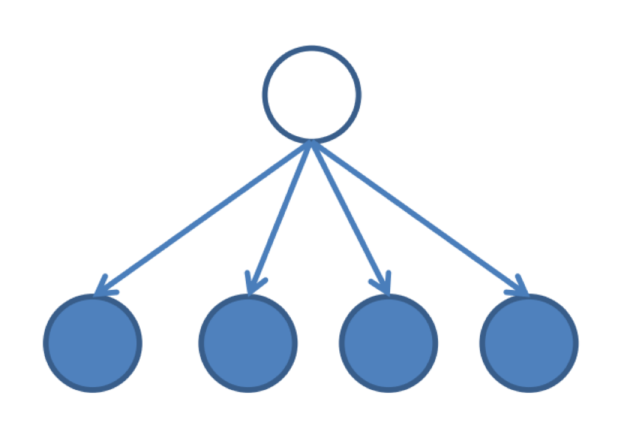

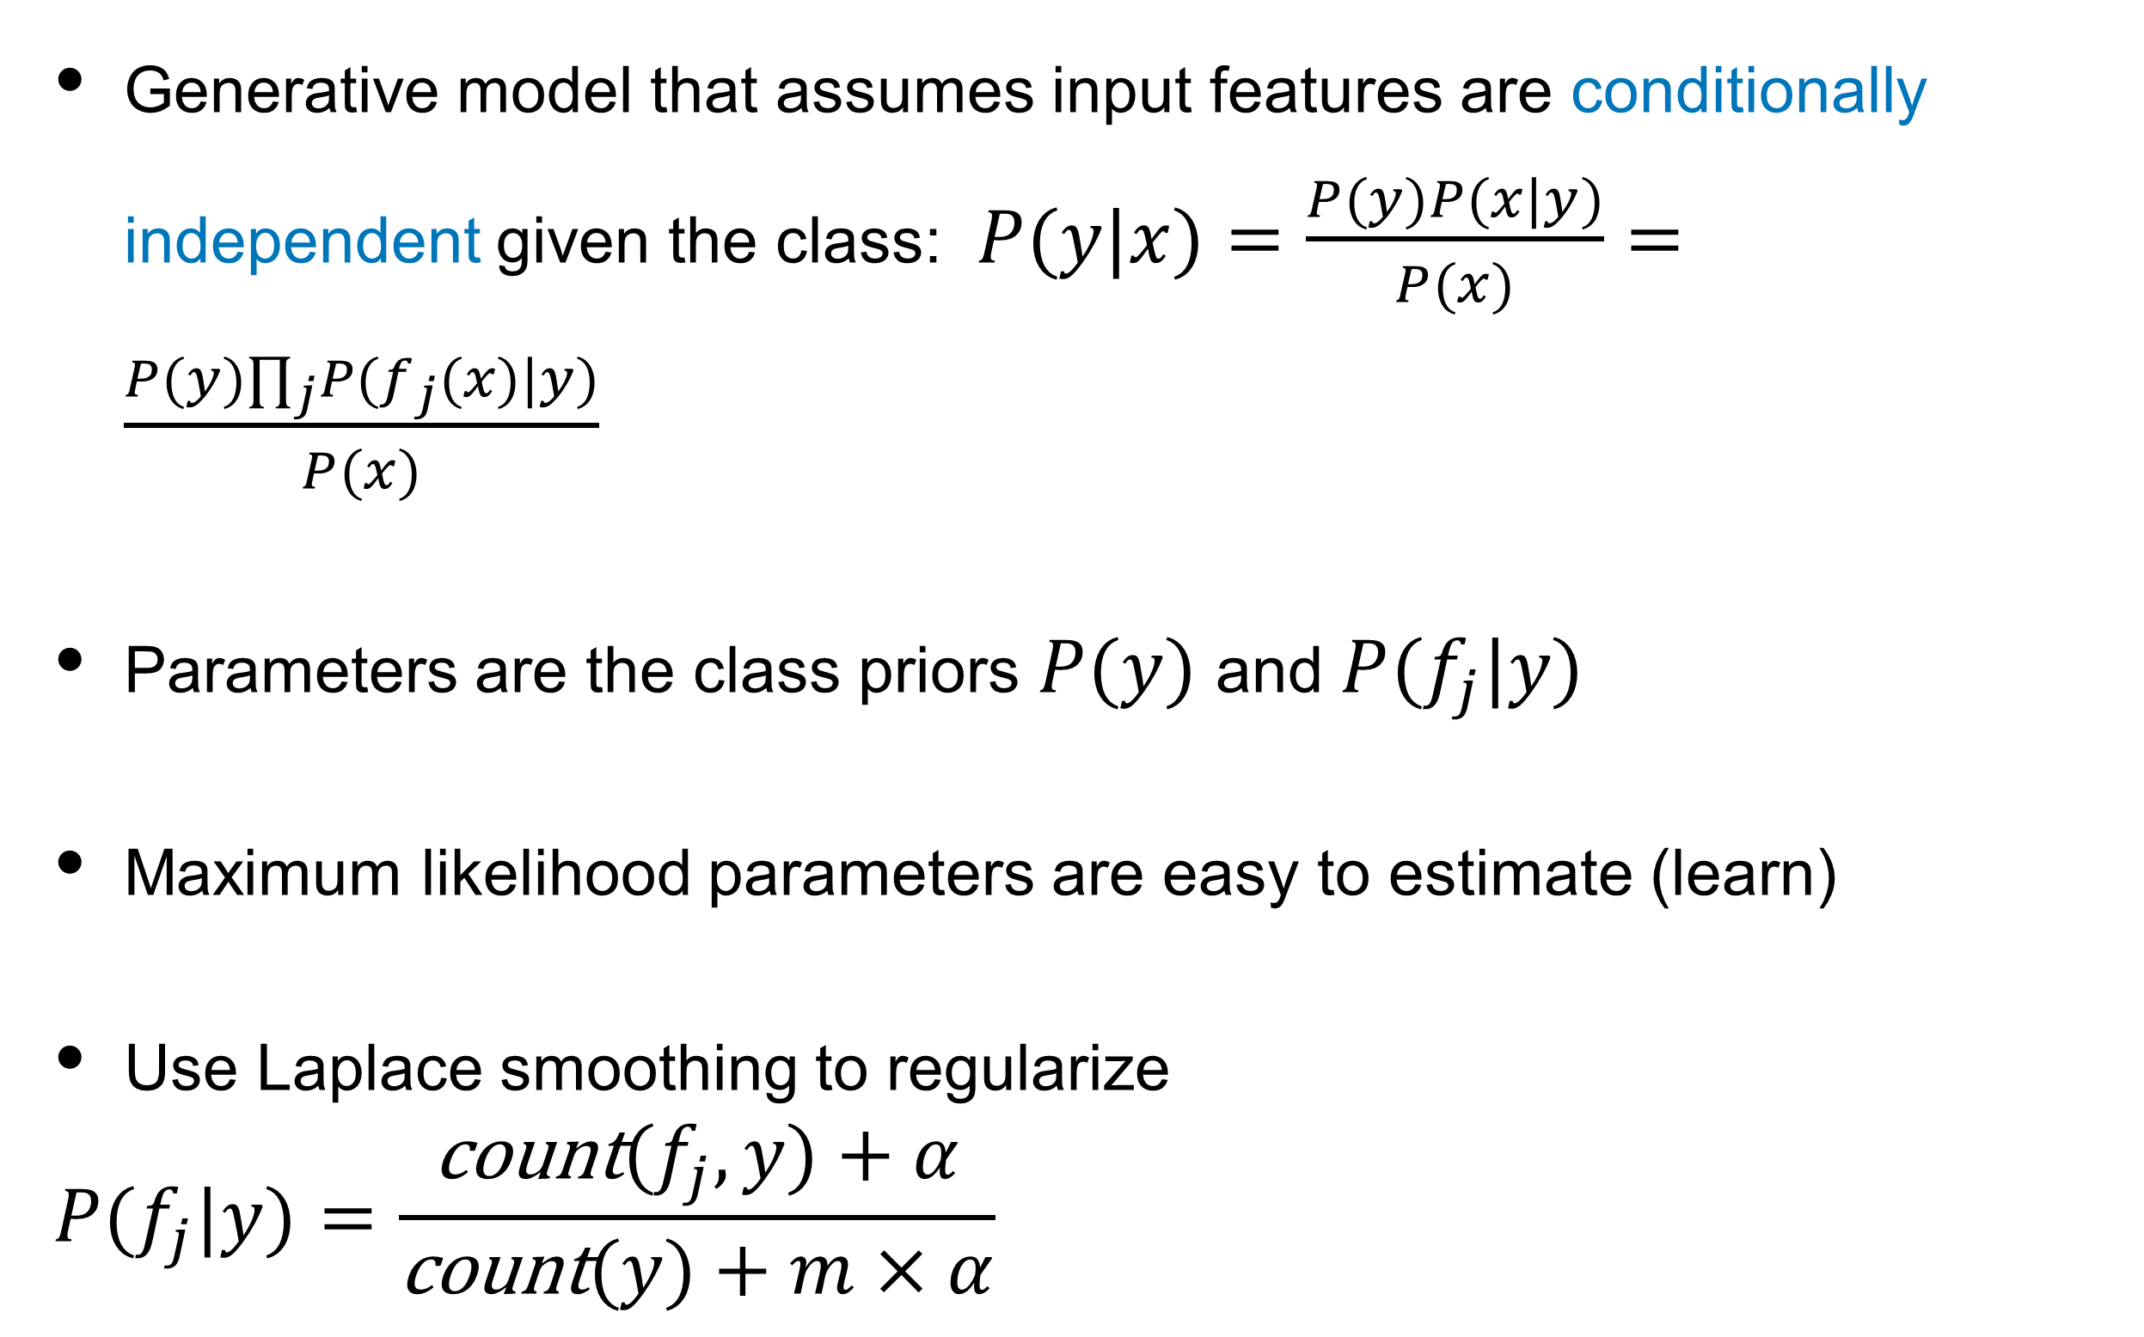
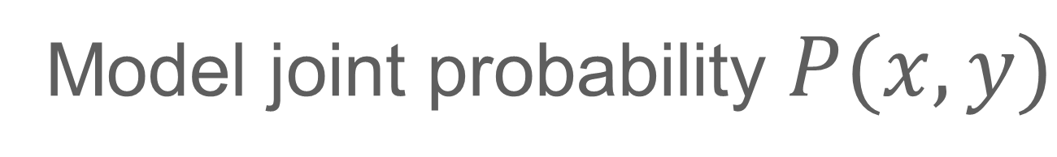
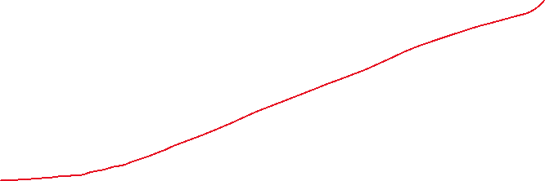
Multinomial Naive Bayes
Generative model that assumes input features are conditionally independent given the class: $P(y|x)=\frac{P(y)P(x|y)}{P(x)}=\frac{P(y)∏_{j}P(f_{j}(x)|y)}{P(x)}$
Parameters are the class priors $P(y)$ and $P(f_{j}|y)$
Maximum likelihood parameters are easy to estimate (learn)
Use Laplace smoothing to regularize
  $$P(f_{j}|y)=\frac{\text{count}(f_{j},y)+α}{\text{count}(y)+m×α}$$
Multinomial refers to the distribution of the features
Generative model
Model joint probability $P(x,y)$
For BOW model, $f_{j}$ are the words and $m=|V|$
Notes:
If features are continuous, and we use a Gaussian distribution to model them, we will get a softmax form similar to in logistic regression
Not necessarily a linear classifier (depending on the distribution of the features), but in many cases linear. Linear for multinomial.
Bayesian decision: predict class minimizing expected conditional loss: L_i = L(\hat{y}, y) P(y|x)
Same as using symmetric Dirichlet distribution with parameter α as a prior distribution.

Slide 4
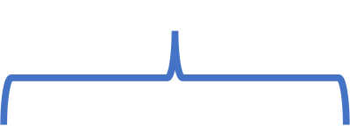
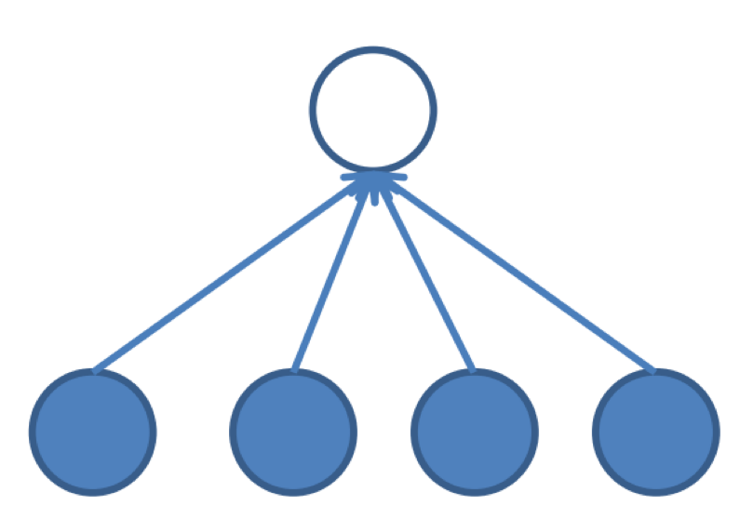
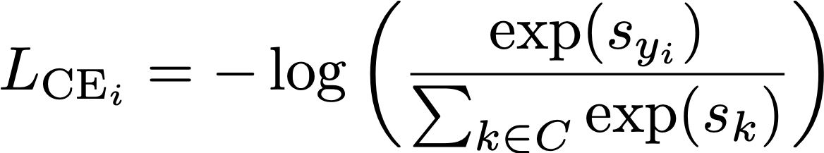

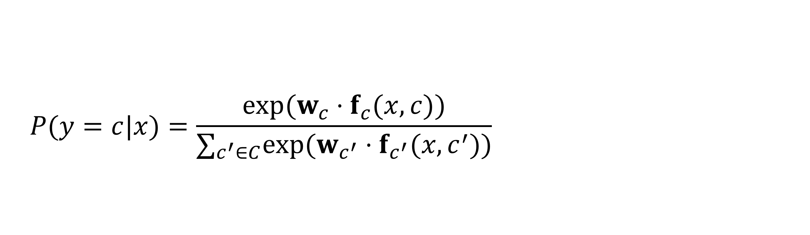
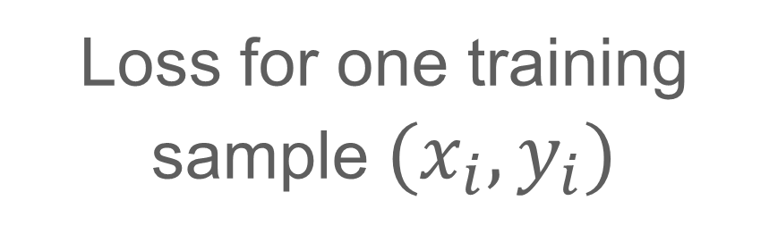
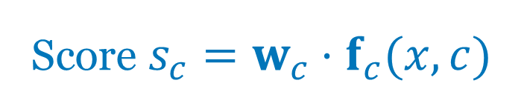
Logistic Regression
  $$P(y=c|x)=\frac{exp(w_{c}⋅f_{c}(x,c))}{∑_{c^{′}∈C}exp(w_{c^{′}}⋅f_{c^{′}}(x,c^{′}))}$$
Models $P(y|x)$ as logistic function (or softmax for >2 classes)
Score $s_{c}=w_{c}⋅f_{c}(x,c)$
Generalization of the logistic function
Parameters are weights $w$
Features are hand designed
Does not have independence assumption
Train to maximize conditional log-probability
Maximizing conditional log-probability = Minimizing Cross-Entropy loss
Also known as Log-linear Model or Maximum Entropy model for classification
Loss for one training sample $(x_{i},y_{i})$
Discriminative model
Model decision boundary directly
Notes:
https://www.cs.cmu.edu/~tom/mlbook/NBayesLogReg.pdf
Gaussian Naive Bayes models the P(y|x) using the same parametric form, but still has the independence assumption. So how it is trained is different (the weights that are learned is typically different unless the independence assumptions actually hold for the data). If the features are actually conditionally independent of the class, then the Logistic Regression and Gaussian Naive Bayes will converge toward identical classifiers.

Slide 5
Types of supervised classifiers
Naive Bayes
Logistic regression
Neural networks
Support vector machines
k-nearest neighbors

Slide 6
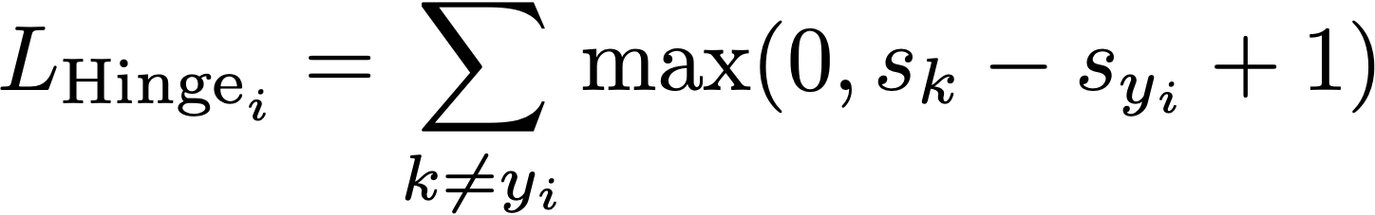
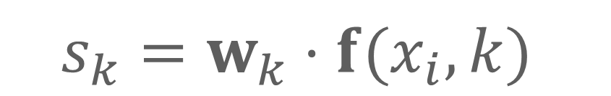
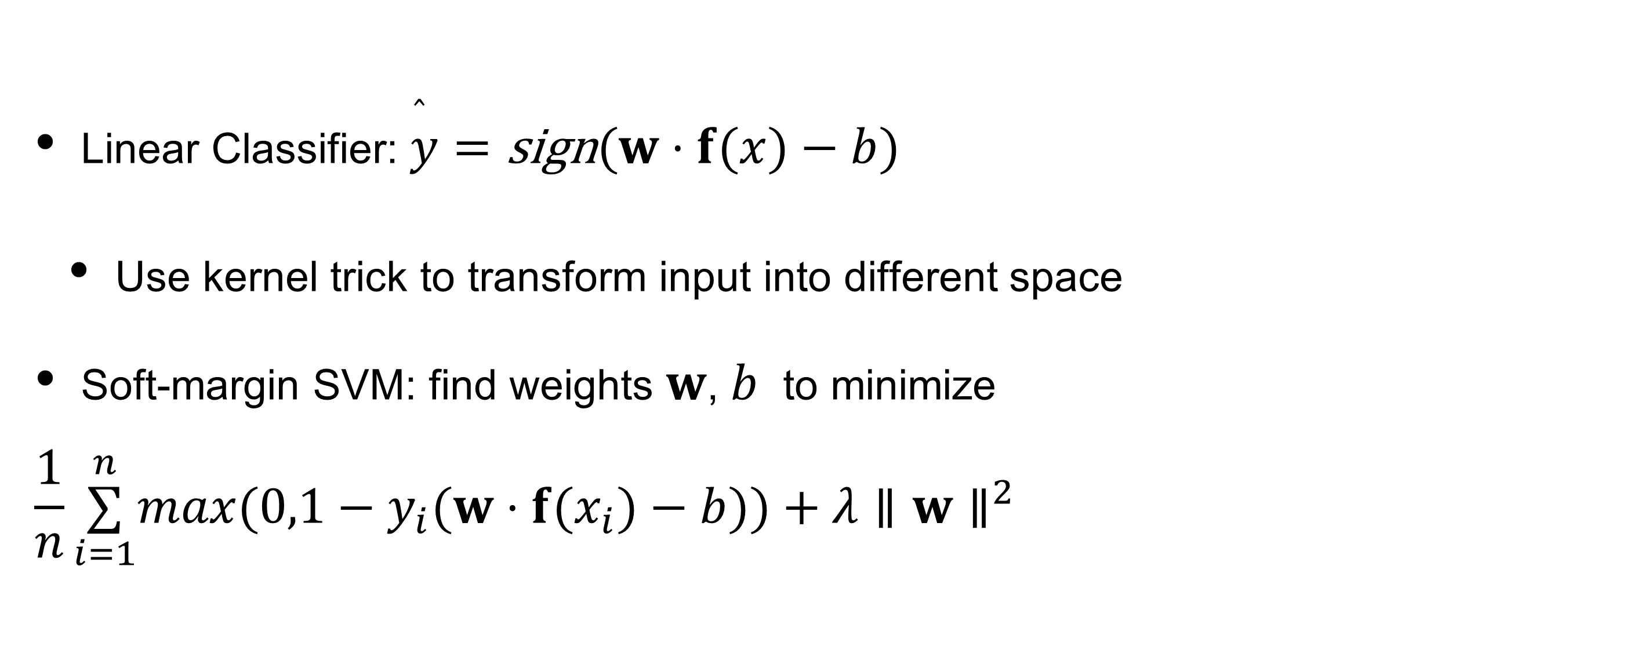

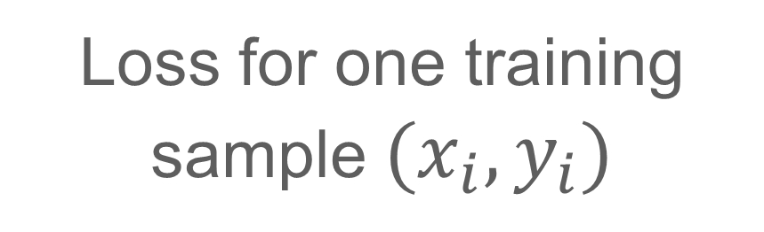


SVM (Support Vector Machines)
A long derivation
Margin Classifier
  Find separating hyperplane that maximizes margin
Linear Classifier: $\overset{̂}{y}=\text{sign}(w⋅f(x)−b)$
  Use kernel trick to transform input into different space
Soft-margin SVM: find weights $w$, $b$ to minimize
  $$\frac{1}{n}\overset{n}{\underset{i=1}{∑}}max(0,1−y_{i}(w⋅f(x_{i})−b))+λ∥w∥^{2}$$
Binary classes: +1, -1
score $s$
Hinge loss /max-margin loss
Multiclass hinge loss
Loss for one training sample $(x_{i},y_{i})$
(upper bound on 0-1 loss)
$$s_{k}=w_{k}⋅f(x_{i},k)$$
$$s_{y_{i}}=w_{y_{i}}⋅f(x_{i},y_{i})$$

Slide 7
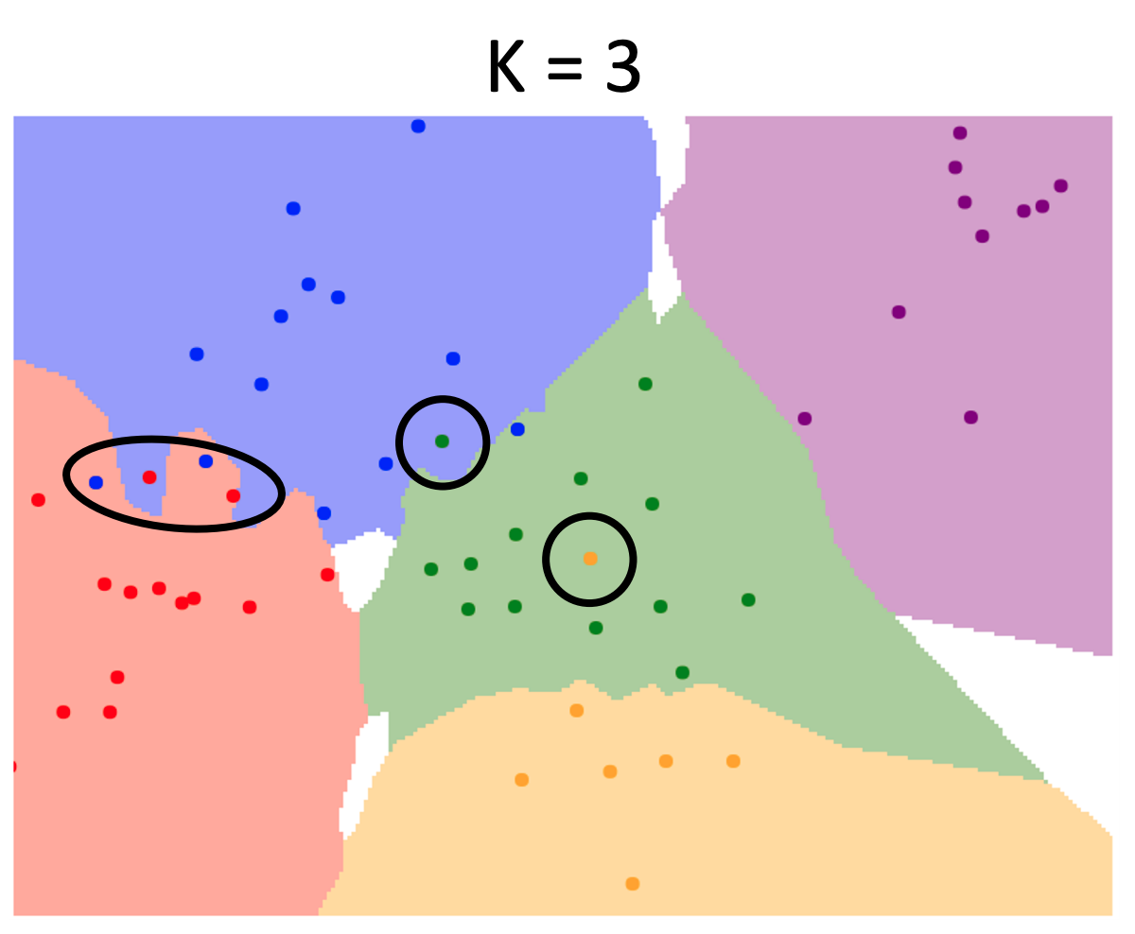
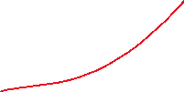
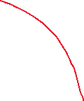
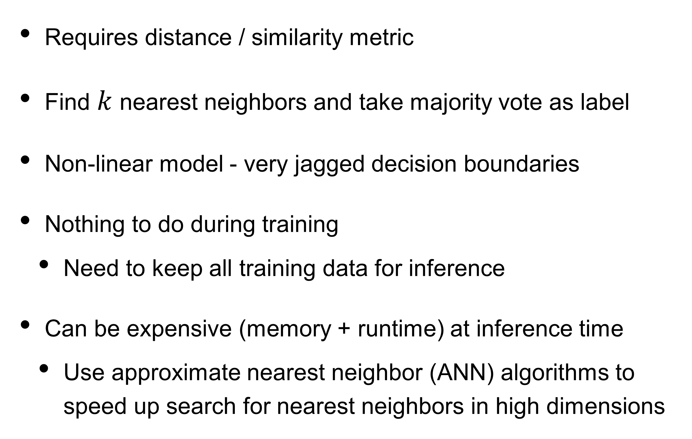

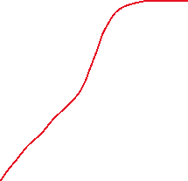

kNN (Nearest Neighbors)
Requires distance / similarity metric
Find $k$ nearest neighbors and take majority vote as label
Non-linear model - very jagged decision boundaries
Nothing to do during training
  Need to keep all training data for inference
Can be expensive (memory + runtime) at inference time
  Use approximate nearest neighbor (ANN) algorithms to speed up search for nearest neighbors in high dimensions
Ground truth: red
From test set
Image Credits: Justin Johnson

Slide 8
Types of supervised classifiers
Naive Bayes
Logistic regression
Neural networks
Support vector machines
k-nearest neighbors

Slide 9
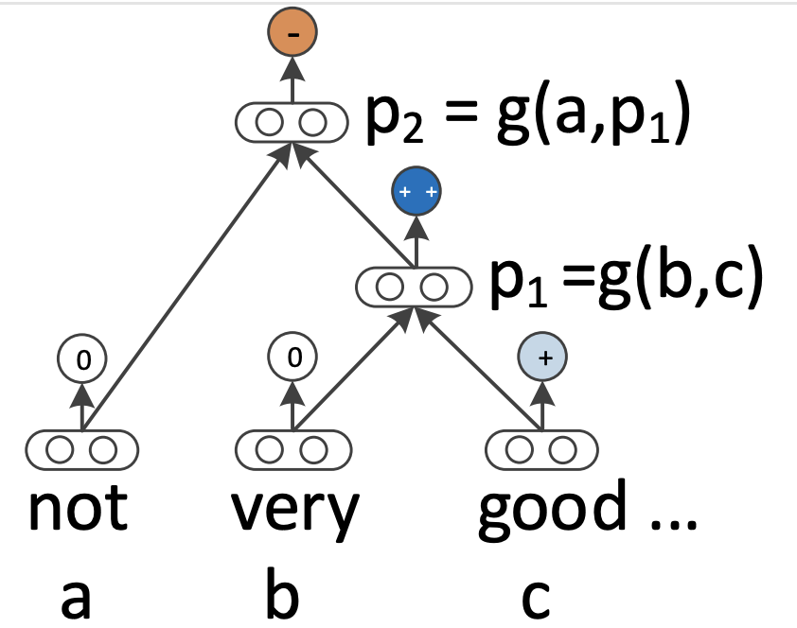
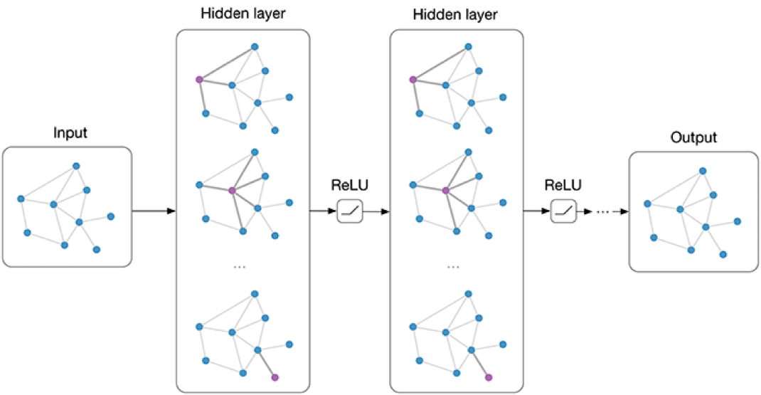
Neural networks for NLP
Feed-forward NNs
Recurrent NNs
Recursive NNs
Convolutional NNs
Transformer
Graph NNs
Always coupled with word embeddings…

Slide 10
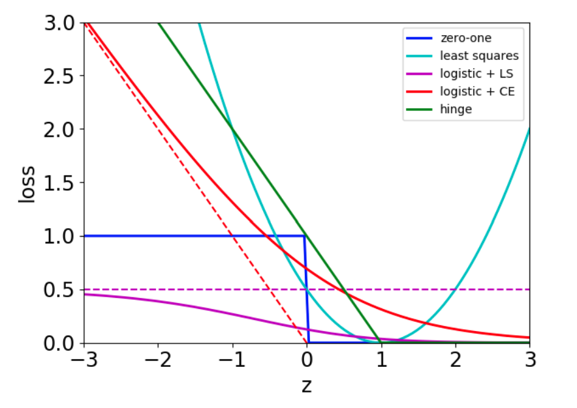
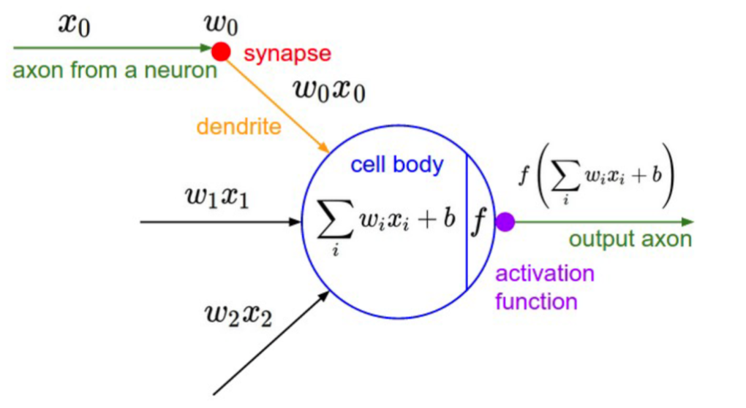
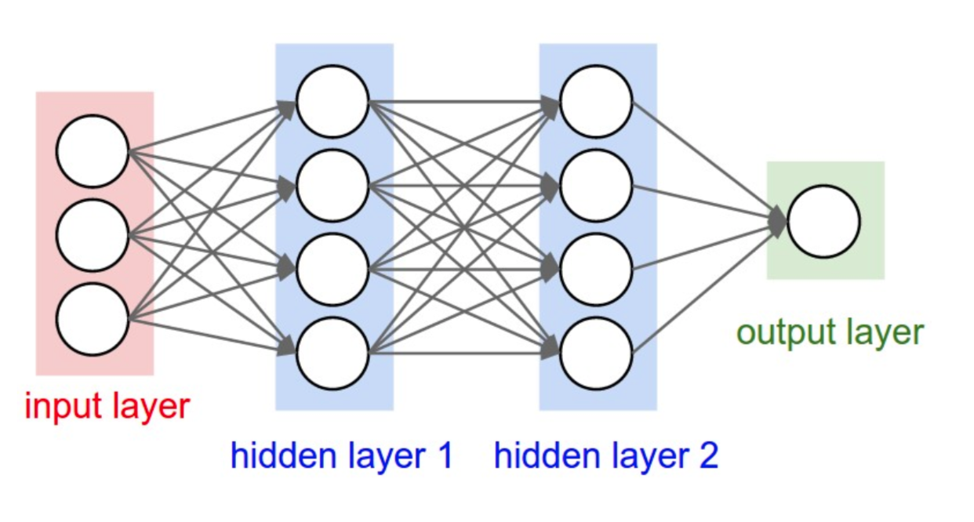
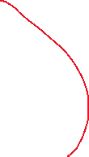
Neural Networks
Logistic + least squares
Different Loss Functions
Hookup neurons (computation units with non-linear activation functions) into networks
Universal function approximations (for arbitrary width or depth)
Mix-and-match different loss functions and optimizers
Image Credits: Roger Grosse
Non-convex

Slide 11



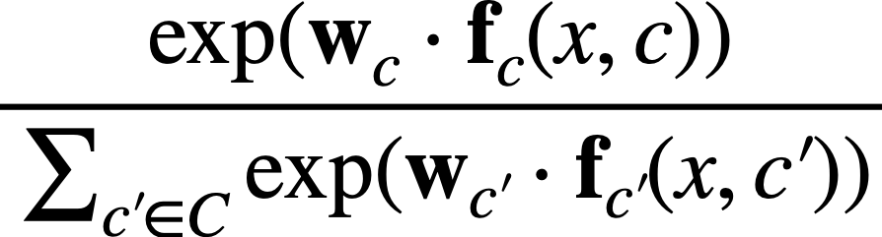


Summary of the different models
 |  | Features | Function Family | Linear | Parameters | Loss | Optimization
Multinomial Naive Bayes |  |  |  | Y | P(y), P(fj|y) | 0-1 loss | Estimate probabilities with counts
Logistic Regression |  |  |  | Y | Weights w | Cross Entropy | Convex
SVM |  |  |  | Y | Weights w | Hinge | Convex
kNN |  |  |  | N
Neural Network |  | Learned from input |  | N | Network parameters | You choose! | Non-convex Auto-differentiation with SGD + friends
Typically,
hand designed features
bias rolled into weights
bias rolled into weights
No optimization of parameters
(but there are hyperparameters)
Need distance/similarity metric

Slide 12
Activation functions

Slide 13
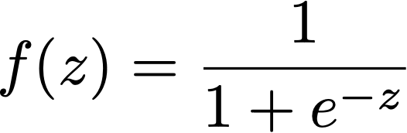
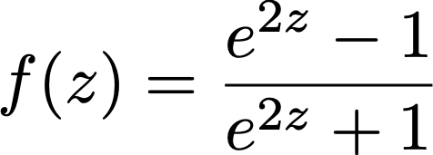

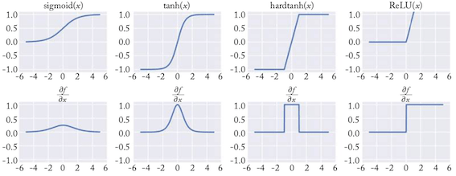
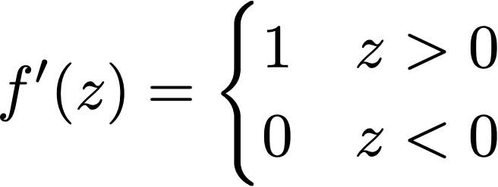


Activation functions
Zero centered
Advantages of ReLU?
sigmoid
tanh
ReLU
(rectified linear unit)
Notes:
Tanh better than sigmoid since it is zero-centered. If not zero-centered, not so good for later neurons (gradients all positive/negative, so tend to zigzag, but overall not that bad)
The technical advantages of the ReLU over the sigmoid and tanh activation functions is that it does not involve expensive-to-compute functions, and more importantly that it does not saturate. The sigmoid and tanh activation are capped at 1, and the gradients at this region of the functions are near zero, driving the entire gradient near zero. The ReLU activation does not have this problem, making it especially suitable for networks with multiple layers, which are susceptible to the vanishing gradients problem when trained with the saturating units.
Gradient - differentiable? saturation?
Range - is it important that the output is between 0 and 1 (normalized)?
Is it zero centered?
Identity near zero?
Monotonic

Slide 14
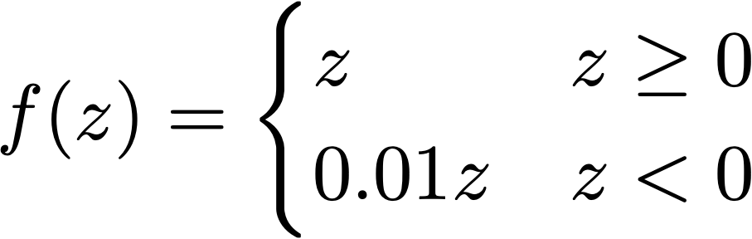
Activation functions
Problems of ReLU?
“dead neurons”
Leaky ReLU

Slide 15
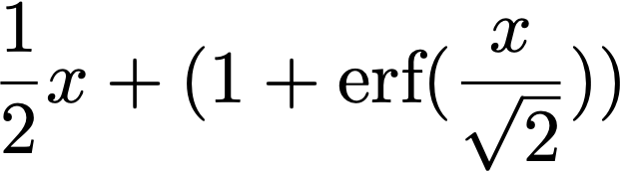
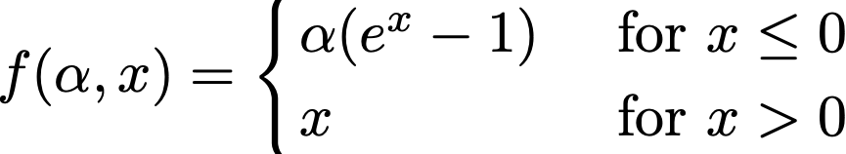
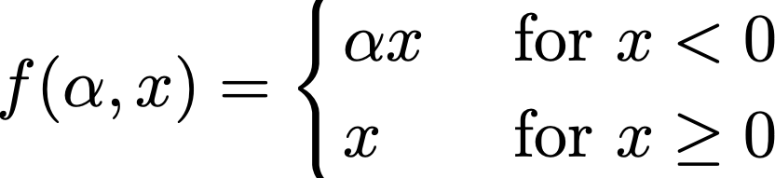
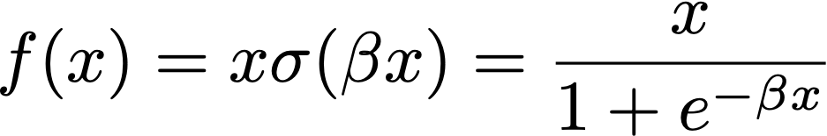
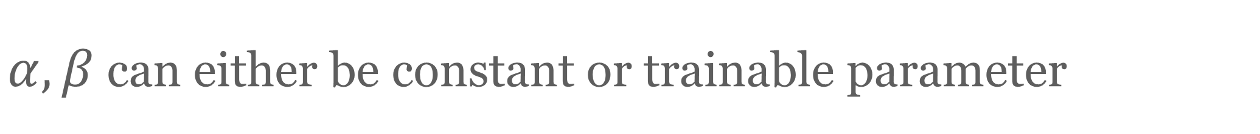
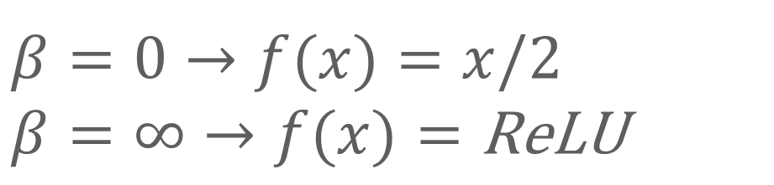
What is the best activation function?
Depends on the problem!
ReLU/Leaky ReLU is often a good choice
Research into families of activation functions
Parameteric rectified linear unit
(PReLU)
Swish
Exponential rectified linear unit (ELU)
$α,β$ can either be constant or trainable parameter
$$β=0→f(x)=x/2$$
$$β=∞→f(x)=\text{ReLU}$$
Notes:
Swish was the end result of comparing all the auto-generated activation functions for accuracy on standard datasets

Slide 16
Expressiveness of neural networks

Slide 17
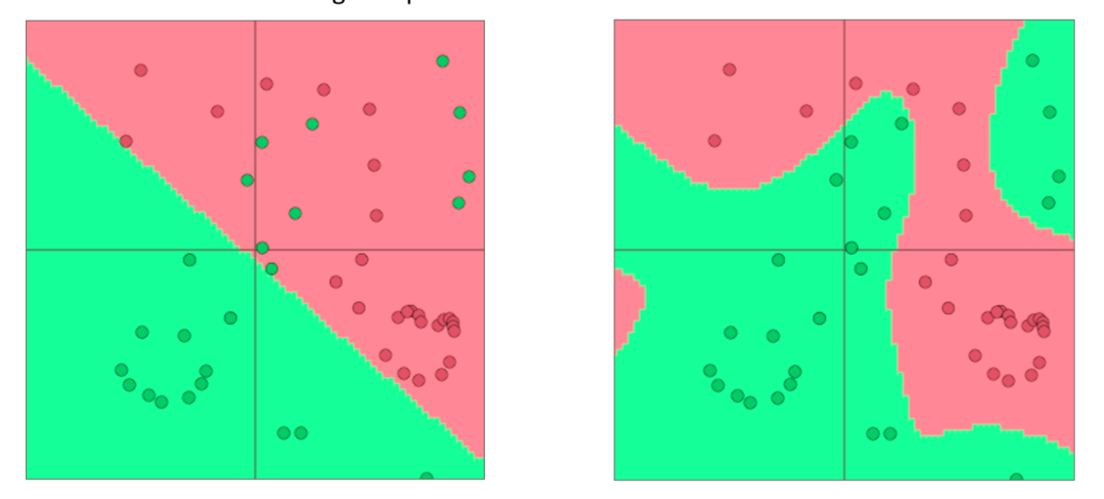
Why non-linearities?
Neural networks can learn much more complex functions and nonlinear decision boundaries
The capacity of the network increases with more hidden units and more hidden layers
What if we remove activation function?

Slide 18
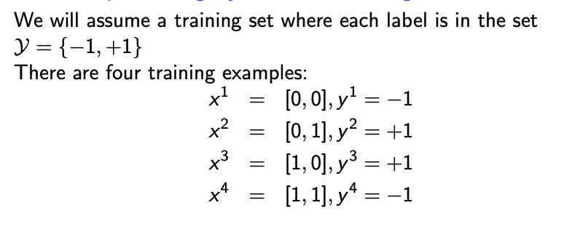
XOR problem
Exclusive OR
it is the simplest example of a dataset that is not linearly separable

Slide 19
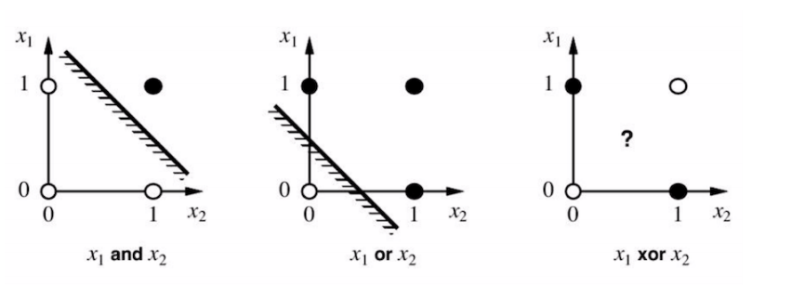
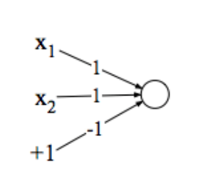
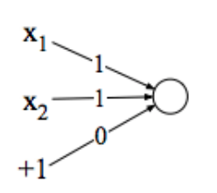
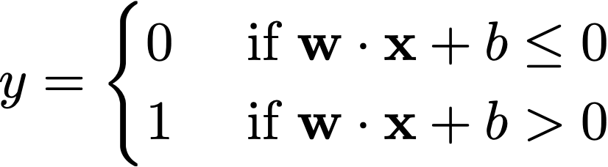



Single neuron (perceptron)
Perceptron can compute and and or

Slide 20
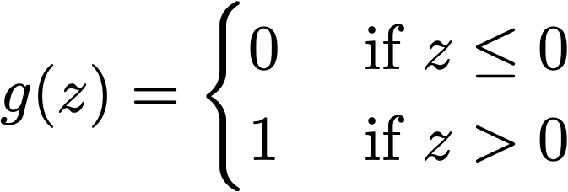
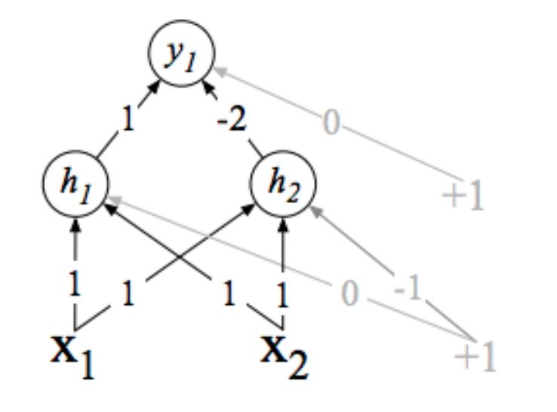
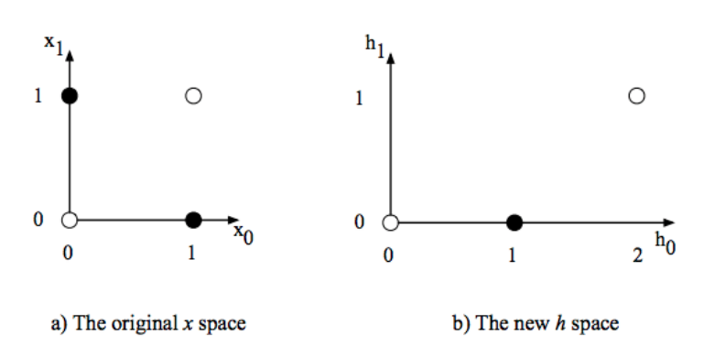
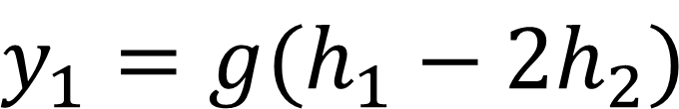
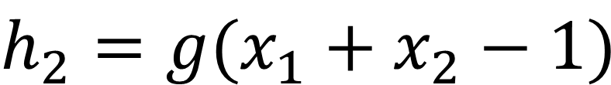
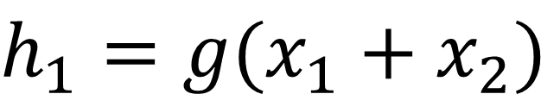
Multiple neurons for XOR
$$y_{1}=g(h_{1}−2h_{2})$$
$$h_{1}=g(x_{1}+x_{2})$$
$$h_{2}=g(x_{1}+x_{2}−1)$$

Slide 21


Why nonlinearities
Learn to classify whether points should belong to the blue curve or red curve
Linear decision boundary
in transformed space
Linear decision boundary
Non-linear decision boundary
https://colah.github.io/posts/2014-03-NN-Manifolds-Topology/

Slide 22


Expressiveness of neural networks
Multilayer feed-forward neural nets with nonlinear activation functions are universal approximators
True for both shallow networks (infinitely wide) and (infinitely) deep networks.
Consider a network with just 1 hidden layer (with hard threshold activation functions) and a linear output. By having $2^{D}$ hidden units, each of which responds to just one input configuration, can model any boolean function with $D$ inputs.
Deep network can provide a more compact representation

Slide 23
Math notation for neural networks

Slide 24






Mathematical Notations
Input layer: $x_{1},…,x_{d}$
Hidden layer 1: $h_{1}^{(1)},h_{2}^{(1)},…,h_{d_{1}}^{(1)}$
Hidden layer 2: $h_{1}^{(2)},h_{2}^{(2)},…,h_{d_{2}}^{(2)}$
Output layer:

Slide 25















Matrix Notations
Input layer:
Hidden layer 1:
Hidden layer 2:
Output layer:
Note: f is applied element-wise

Slide 26









Matrix Notation
Learn parameters
scalar
Output
Input
vector

Slide 27











Matrix Notation
Learn parameters
Output
Input

Slide 28
Training neural networks
Need loss functions and optimization algorithm

Slide 29






Loss functions
Binary classification
Regression
Ground truth label
Multi-class classification ($C$ classes)
Adding regularization to avoid overfitting

Slide 30

Regularization
Optimizing may fit training set too well! (including noisy features)
Poor generalization to the unseen test set — Overfitting
https://www.kaggle.com/code/ryanholbrook/overfitting-and-underfitting

Slide 31

Regularization
Optimizing may fit training set too well! (including noisy features)
Poor generalization to the unseen test set — Overfitting
Regularization helps prevent overfitting
  Add regularization term:
  Use dropout (common for neural networks)
Penalize large weights

Slide 32


Dropout
aka how to train $2^{n}$ neural networks when it has $n$ units
Randomly drop some neurons
Helps avoid over-fitting to training
Cannot rely on small set of simple “features”
https://jmlr.org/papers/v15/srivastava14a.html
https://arxiv.org/abs/1207.0580
Notes:
Contour sets where the function has the same value

Slide 33

Loss functions
Binary classification
Regression
Ground truth label
Multi-class classification ($C$ classes)
How find parameters to minimize

Slide 34


Optimization
Optimize using Stochastic Gradient
Logistic regression is convex: one global minimum
Neural networks are non-convex and not easy to optimize
Improvements to SGD: a class of more sophisticated “adaptive” optimizers that scale the parameter adjustment by an accumulated gradient.
    AdamW / Adam
    Adagrad
    …
(Ruder 2016): An overview of gradient descent optimization algorithms
(https://ruder.io/optimizing-gradient-descent/)

Slide 35


Credit: Mo Chen, Pierre Vigier

Slide 36


Damping rate
Credit: Mo Chen, Pierre Vigier

Slide 37
Damping rate
𝛼 ∈ [0,1) is a hyperparameter
and is known as the
“momentum parameter”
Credit: Mo Chen, Pierre Vigier

Slide 38



Detail: refer to Machine Learning
Too fast: slow down
Too slow: speed up
Credit: Mo Chen, Pierre Vigier

Slide 39


Detail: refer to Machine Learning
Too fast: slow down
Too slow: speed up
Preconditioner
Credit: Mo Chen, Pierre Vigier

Slide 40

Credit: Mo Chen, Pierre Vigier

Slide 41
Using SGD
Decay learning rate
Mini-batch (update after seeing m samples)
  Less variance than pure SGD
  More efficient than updating the weights after every sample
  Randomize/shuffle samples in each mini-batch
There is a cost to updating weights
Notes:
https://machinelearningmastery.com/gentle-introduction-mini-batch-gradient-descent-configure-batch-size/
Shuffles samples helps the optimizer see different random subsets of the data, get out of local optimal

Slide 42
Optimization
Standard/Vanilla SGD: update with only gradients
Momentum: update w/ running average of gradients
  Prevent instability from sudden changes
Adagrad: different learning rate for each parameter
  update down weighs high variance values
Adam: update w/ running average of gradient, down weights by running average of variance
AdamW: improve version of Adam when using L2 regularization
More details: tutorial on optimization
Blog: https://ruder.io/optimizing-gradient-descent/
Adapted from slide by Graham Neubig
Notes:
Maybe SGD

Slide 43
Neural networks as
computational graphs

Slide 44
































Computational graph
$$x$$
$$W_{1}x$$
$$z_{1}$$
$$⋅$$
$$+$$
$$f_{1}$$
$$h_{1}$$
$$W_{2}h_{1}$$
$$z_{2}$$
$$⋅$$
$$+$$
$$f_{2}$$
$$h_{2}$$
$$W_{o}h_{2}$$
$$z_{o}$$
$$W_{1}$$
$$b_{1}$$
$$+$$
$$σ$$
$$⋅$$
$$y$$
$$W_{2}$$
$$b_{2}$$
$$f_{L_{CE}}$$
$$W_{o}$$
$$b_{o}$$
Focus on computation
Nodes represent operations
Edges are values from one operator to the next
$$y^{∗}$$
$$L_{CE}$$
Forward pass: compute function value
Backward pass: gradient using chain rule

Slide 45

























Simplified example
Forward pass: compute function value
$$x$$
$$Wx$$
$$z$$
$$y$$
$$⋅$$
$$+$$
$$σ$$
$$f_{L}$$
$$L$$
$$W$$
$$b$$
Backward pass: gradient using chain rule
$$\frac{∂L}{∂y}$$
$$\frac{∂L}{∂L}$$
$$\frac{∂L}{∂Wx}$$
$$\frac{∂L}{∂z}$$
$$\frac{∂L}{∂y}$$
$$x$$
$$x$$
$$f_{L}$$
$$+$$
$$f_{L}$$
$$+$$
$$L$$
$$σ$$
$$L$$
$$⋅$$
$$σ$$
$$⋅$$
Good news is that modern automatic differentiation tools did all for you!
$$\frac{∂L}{∂W}$$
$$\frac{∂L}{∂b}$$
Implementing backprop by hand is like programming in assembly language.
$$b$$
$$W$$
$$b$$
$$W$$

Slide 46








Backpropagation: single node
$$h=f(z)$$
$$f$$
$$z$$
$$h$$
$$\frac{∂h}{∂z}=\frac{∂f(z)}{∂z}$$
$$\frac{∂L}{∂z}=\frac{∂L}{∂h}\frac{∂h}{∂z}$$
$$\frac{∂L}{∂h}$$
Downstream
gradient
=
Local
gradient
$$×$$
Upstream
gradient
Gradient wrt input

Slide 47














Backpropagation
Multiple inputs
Multiple output branches
$$f_{1}$$
$$x_{1}$$
$$z_{1}$$
$$f$$
$$x$$
$$\frac{∂L}{∂x_{1}}=\frac{∂L}{∂z}\frac{∂z}{∂x_{1}}$$
$$z=f(x_{1},x_{2})$$
$$\frac{∂L}{∂z}$$
$$x$$
$$f_{2}$$
$$x_{2}$$
$$z_{2}$$
$$\frac{∂L}{∂x_{2}}=\frac{∂L}{∂z}\frac{∂z}{∂x_{2}}$$
Sum gradients of branches
Compute gradients for each input

Slide 48





Backpropagation API
Multiple inputs
$$x_{1}$$
Each node (operator) implement local forward/backward API
  forward(inputs)
    $f(x_{1},…,x_{k})$
  backward(upstream gradient)
  $\frac{∂f}{∂x_{1}},\frac{∂f}{∂x_{2}},…,\frac{∂f}{∂x_{k}}$
$$f$$
$$\frac{∂L}{∂x_{1}}=\frac{∂L}{∂z}\frac{∂z}{∂x_{1}}$$
$$f(x_{1},x_{2})$$
$$\frac{∂L}{∂z}$$
$$x_{2}$$
$$\frac{∂L}{∂x_{2}}=\frac{∂L}{∂z}\frac{∂z}{∂x_{2}}$$
Chain them together to form computation graph
Reuse derivatives to minimize computation

Slide 49

Example: MultiplyGate
http://web.stanford.edu/class/cs224n/readings/cs224n-2019-notes03-neuralnets.pdf
Credits: Chris Manning (Stanford cs224n)

Slide 50
Backpropagation in general computational graph
Forward propagation: visit nodes in topological sort order
  Compute value of node given predecessors
Backward propagation:
  Initialize output gradient as 1
  Visit nodes in reverse order and compute gradient wrt each node using gradient wrt successors
For more details see https://colah.github.io/posts/2015-08-Backprop/

Slide 51














Simplified example
Forward pass: compute function value
Chain rule
Local derivatives
$$x$$
$$Wx$$
$$z$$
$$y$$
$$\frac{∂L}{∂L}=1$$
$$⋅$$
$$+$$
$$σ$$
$$f_{L}$$
$$L$$
$$\frac{∂L}{∂y}=\frac{∂L}{∂f_{L}(y,y^{∗})}\frac{∂f_{L}(y,y^{∗})}{∂y}$$
$$\frac{∂f_{L}(y,y^{∗})}{∂y}=y−y^{∗}$$
$$W$$
$$b$$
Backward pass: gradient using chain rule
$$\frac{∂L}{∂z}=\frac{∂L}{∂y}\frac{∂y}{∂z}=\frac{∂L}{∂y}\frac{∂σ(z)}{∂z}$$
$$\frac{∂σ(z)}{∂z}=σ(z)(1−σ(z))$$
$$\frac{∂L}{∂b}=\frac{∂L}{∂z}\frac{∂z}{∂b}=\frac{∂L}{∂z}\frac{∂(Wx+b)}{∂b}$$
$$\frac{∂(Wx+b)}{∂b}=1$$
$$\frac{∂L}{∂y}$$
$$\frac{∂L}{∂f_{L}}$$
$$\frac{∂L}{∂Wx}$$
$$\frac{∂L}{∂z}$$
$$\frac{∂L}{∂y}$$
$$x$$
$$x$$
$$f_{L}$$
$$+$$
$$f_{L}$$
$$\frac{∂L}{∂Wx}=\frac{∂L}{∂z}\frac{∂z}{∂Wx}=\frac{∂L}{∂z}\frac{∂(Wx+b)}{∂Wx}$$
$$\frac{∂(Wx+b)}{∂Wx}=1$$
$$+$$
$$L$$
$$σ$$
$$L$$
$$⋅$$
$$σ$$
$$⋅$$
$$\frac{∂L}{∂W}$$
$$\frac{∂L}{∂b}$$
$$\frac{∂L}{∂W}=\frac{∂L}{∂Wx}\frac{∂Wx}{∂W}$$
$$\frac{∂Wx}{∂W}=x^{T}$$
$$b$$
$$W$$
$$b$$
$$W$$

Slide 52



An example
Try to compute the gradients yourself!
http://web.stanford.edu/class/cs224n/readings/cs224n-2019-notes03-neuralnets.pdf

Slide 53
Summary of backpropagation
It’s taking derivatives and applying chain rule!
We’ll re-use derivatives computed for higher layers in computing derivatives for lower layers so as to minimize computation
Good news is that modern automatic differentiation tools did all for you!
Implementing backprop by hand is like programming in assembly language.

Slide 54

Designing classifiers
with neural networks
Feature design: partly eliminated,
partly rolled into network design
Input features: $f(x)→[f_{1},f_{2},…,f_{m}]$
  Need to determine features
Output: estimate $P(y=c|x)$ for each class $c$
  Need to model $P(y=c|x)$ with a family of functions
Train phase: Learn parameters of model to minimize loss function
  Need Loss function and Optimization algorithm
Test phase: Apply parameters to predict class given a new input
Neural Networks
figure out architecture
Still need to figure out loss function
General methods using auto-differentiation

Slide 55
Rise of deep-learning frameworks
Pytorch, TensorFlow, …
Provide frequently used components that can be connected together
Easy to build complex models
  Connect up neural building blocks
  Mix and match selection of loss functions, regularizers, and optimizers
Optimize using auto-differentiation, no need to hand code optimizers for specific models
Deals with numerical stability issues
Deals with efficient computation (e.g. batching, using GPUs)
Provides (some) experiment logging and visualization tools
No longer need to code all the pieces of your model and optimizer by yourself
Allows researchers and developers to focus on
Modeling the problem
Designing the network

Slide 56
Resources
There is a lot more to learn about neural networks!
  Self-learn Tutorials
    Optimization
    Pytorch and backpropagation
    Debugging Tips and Tricks
  Classes: CMPT 728 (Deep Learning)

Slide 57
Resources
Deep learning books
  Courville, Goodfellow, and Bengio: https://www.deeplearningbook.org/
  Yoav Goldberg’s Primer on NN models for NLP: http://u.cs.biu.ac.il/~yogo/nnlp.pdf
Classes from other universities
  Stanford CS231n notes: https://cs231n.stanford.edu/
  University of Toronto: https://csc413-2020.github.io/ (Jimmy Ba and Roger Grosse)
  University of Michigan: https://web.eecs.umich.edu/~justincj/teaching/eecs498/FA2020/ (Justin Johnson)

