Slide 1

CMPT 413/713: Natural Language Processing
Word2Vec
Zhiyun (Richard) Peng
2026-10-9
Adapted from slides from Angel Chang, Anoop Sarkar, Danqi Chen and Karthik Narasimhan
Notes:
http://demo.clab.cs.cmu.edu/NLP/

Slide 2
Word2vec and friends

Slide 3
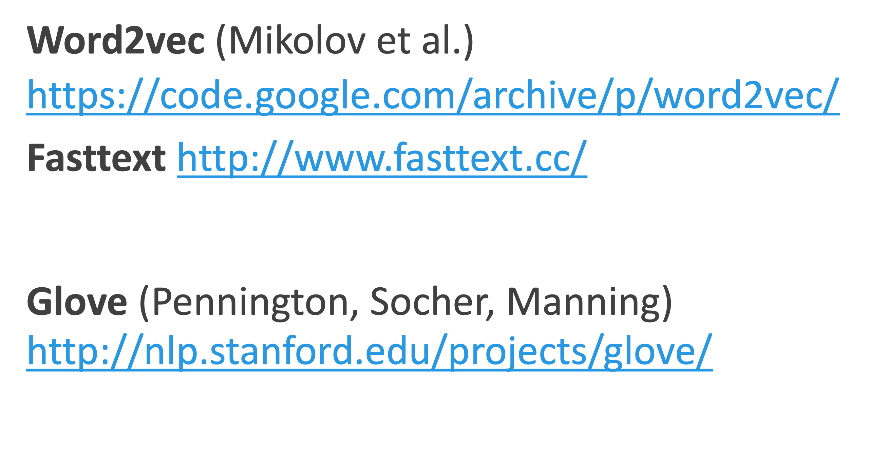


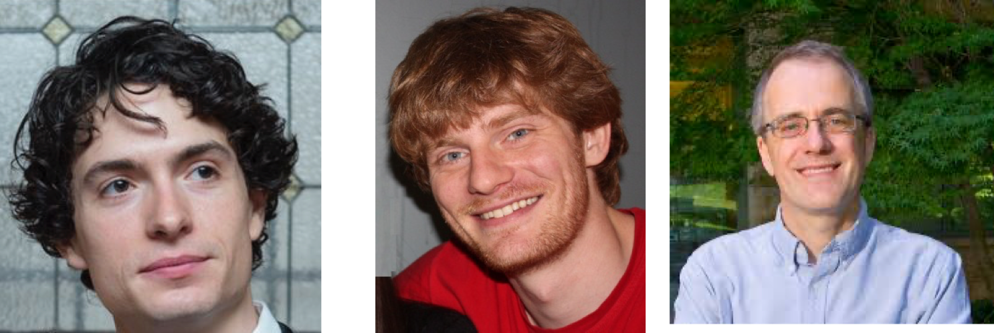

Download pretrained word embeddings

Slide 4
Word2Vec
Popular embedding method
Very fast to train
Idea: predict rather than count
Original word2vec formulation: Efficient Estimation of Word Representations in Vector Space (Mikolov et al, 2013a)
Negative sampling: Distributed Representations of Words and Phrases and their Compositionality (Mikolov et al, 2013b)

Slide 5
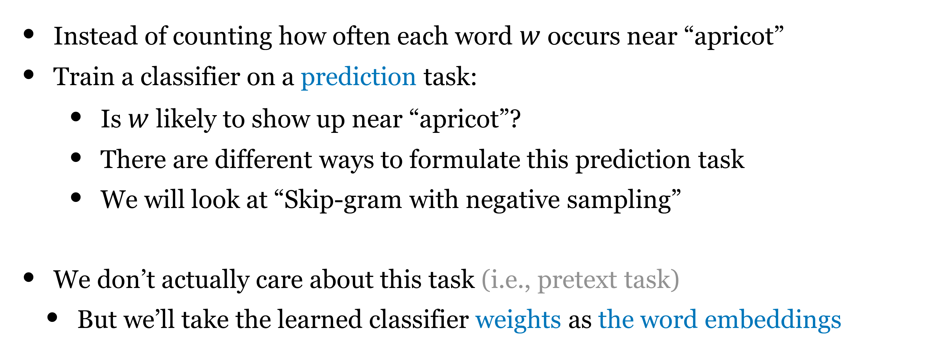
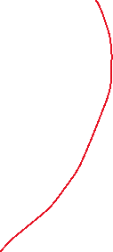
Word2Vec
Instead of counting how often each word $w$ occurs near “apricot”
Train a classifier on a prediction task:
    Is $w$ likely to show up near “apricot”?
    There are different ways to formulate this prediction task
    We will look at “Skip-gram with negative sampling”
We don’t actually care about this task (i.e., pretext task)
  But we’ll take the learned classifier weights as the word embeddings

Slide 6
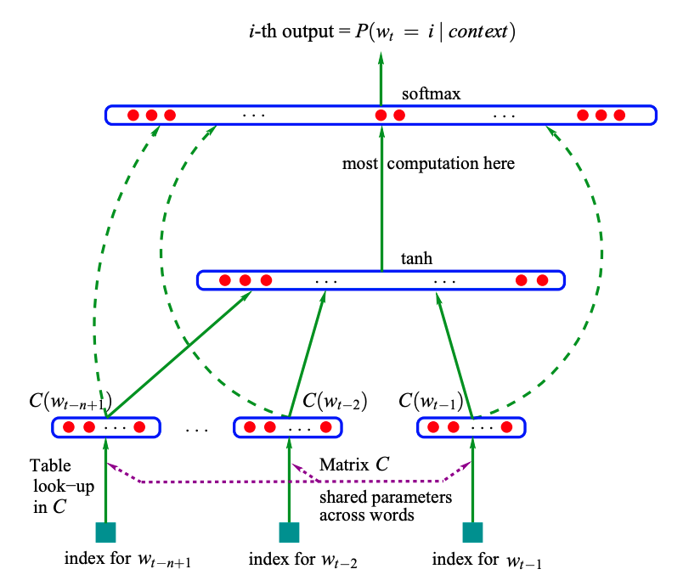
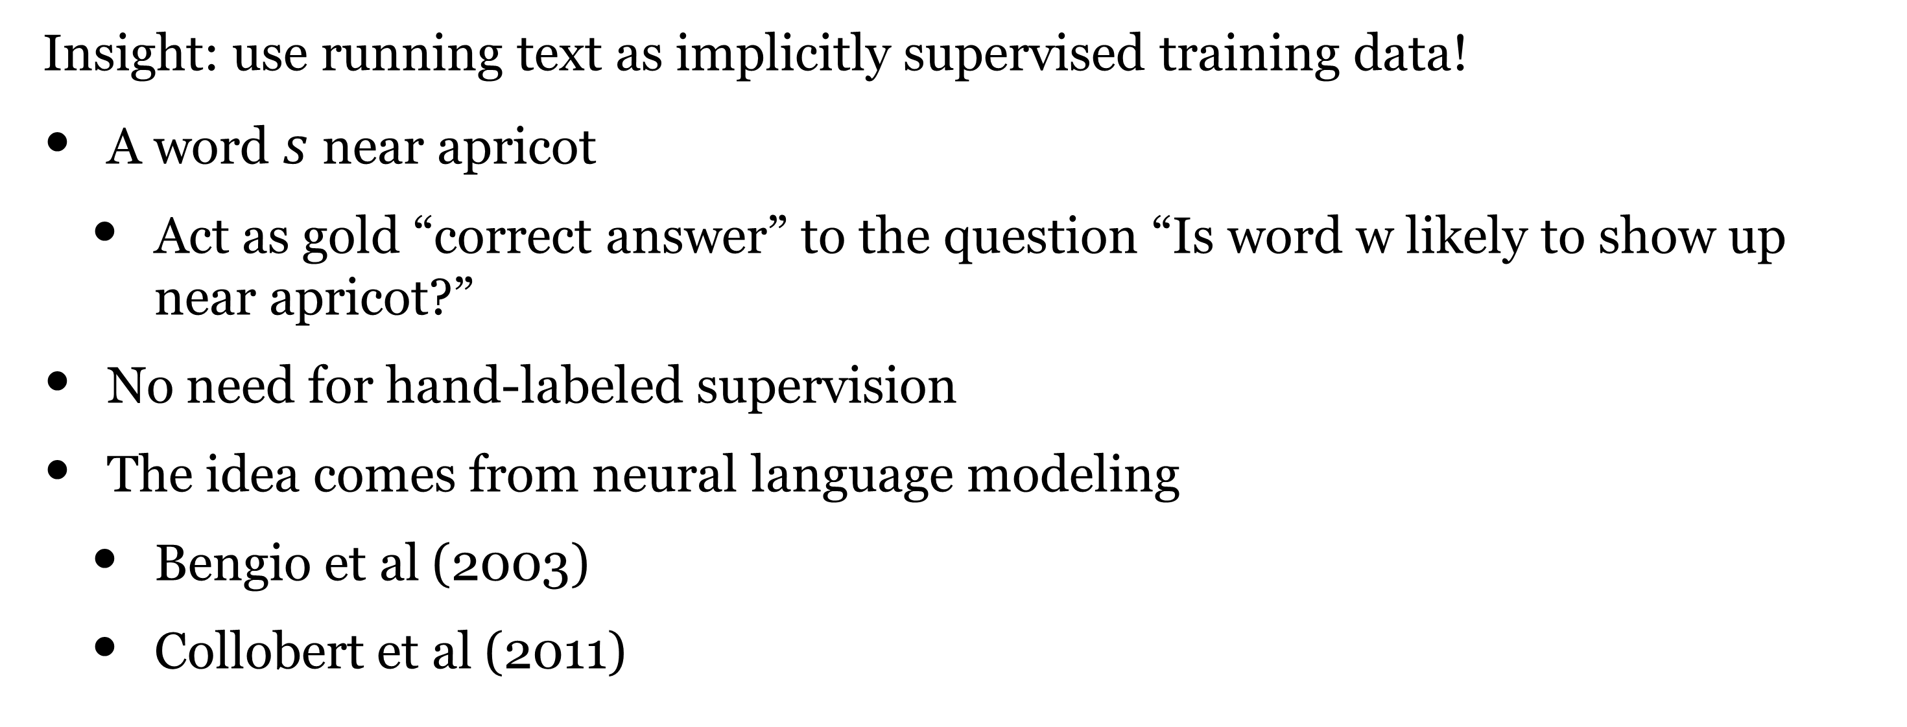



Word2Vec
Insight: use running text as implicitly supervised training data!
A word $s$ near apricot
  Act as gold “correct answer” to the question “Is word w likely to show up near apricot?”
No need for hand-labeled supervision
The idea comes from neural language modeling
  Bengio et al (2003)
  Collobert et al (2011)
(Bengio et al, 2003): A Neural Probabilistic Language Model

Slide 7
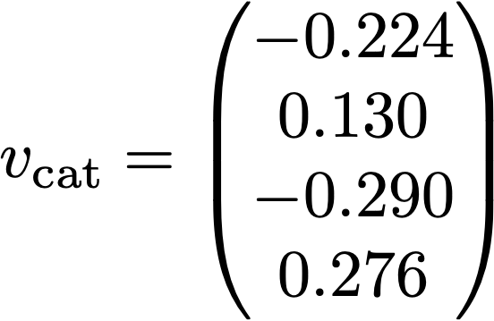
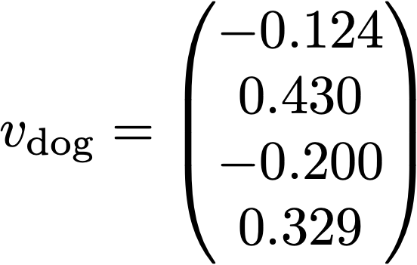
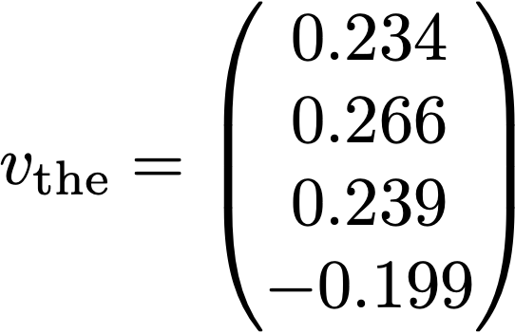
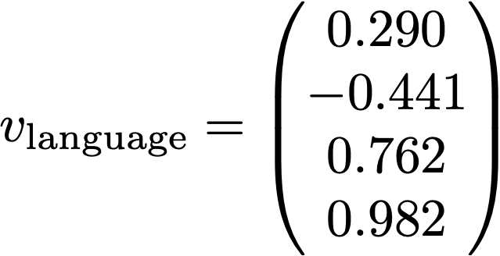
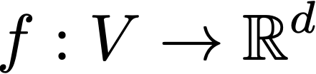
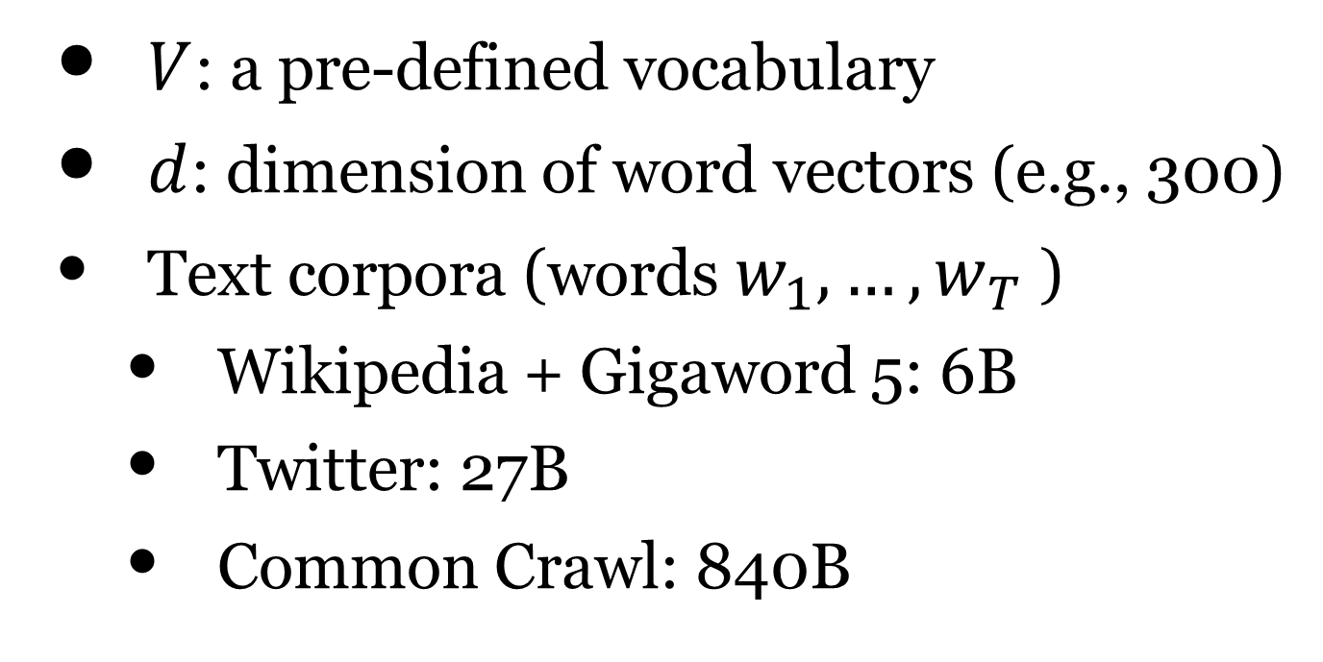
Word2vec
Input: a large text corpora V, d
$V$: a pre-defined vocabulary
$d$: dimension of word vectors (e.g., 300)
Text corpora (words $w_{1},…,w_{T}$ )
  Wikipedia + Gigaword 5: 6B
  Twitter: 27B
  Common Crawl: 840B
Output:
      Learn $f$ by training classifiers to predict words and take learned weights as word vectors.
Notes:
New York Times

Slide 8
Word2vec
word = “sweden”
Notes:
Sweden 瑞典

Slide 9
Word2vec
      Predict center word from context words
      Predict context words from center word
Continuous Bag of Words (CBOW)
Skip-grams

Slide 10
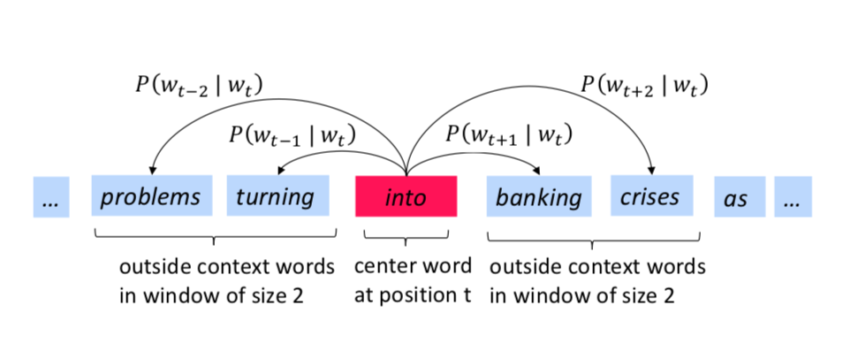
Skip-gram
The idea: we want to use words to predict their context words
Context: a fixed window of size 2m (m = 2 in this example)

Slide 11
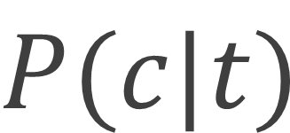
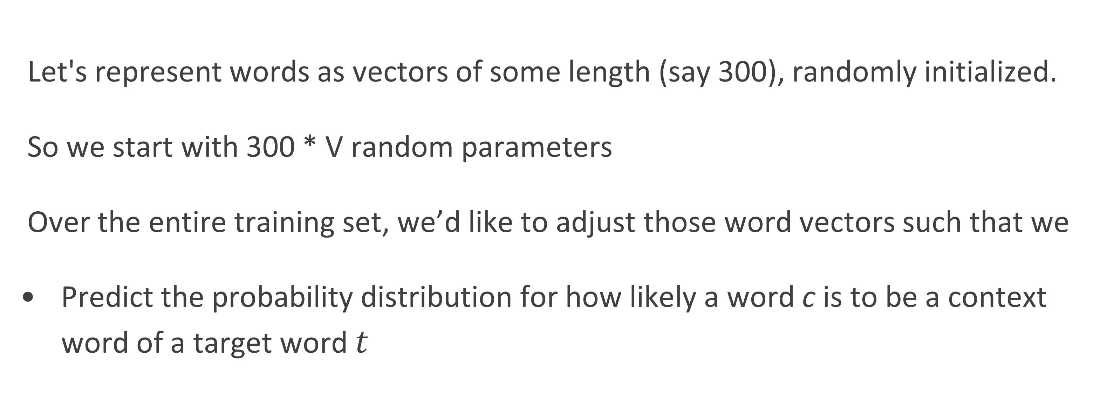
Skip-gram: Basic Setup
Let's represent words as vectors of some length (say 300), randomly initialized.
So we start with 300 * V random parameters
Over the entire training set, we’d like to adjust those word vectors such that we
Predict the probability distribution for how likely a word c is to be a context word of a target word $t$
$$P(c|t)$$

Slide 12

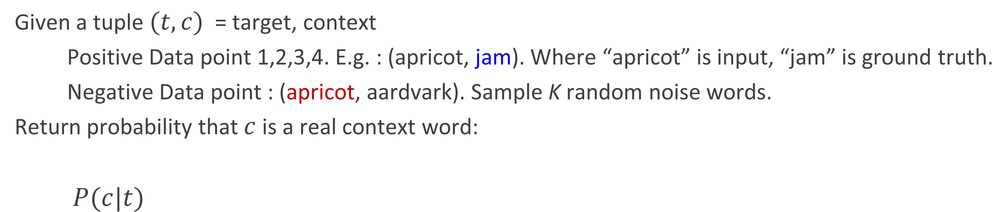







Skip-gram
Training sentence:
... lemon, a tablespoon of apricot jam a pinch ...
c1 c2 t c3 c4
Training data: input/output pairs centering on apricot
assume a +/- 2 word window
Training data
Given a tuple $(t,c)$ = target, context
  Positive Data point 1,2,3,4. E.g. : (apricot, jam). Where “apricot” is input, “jam” is ground truth.
  Negative Data point : (apricot, aardvark). Sample K random noise words.
Return probability that $c$ is a real context word:
$P(c|t)$
Probability distribution
over vocabulary

Slide 13

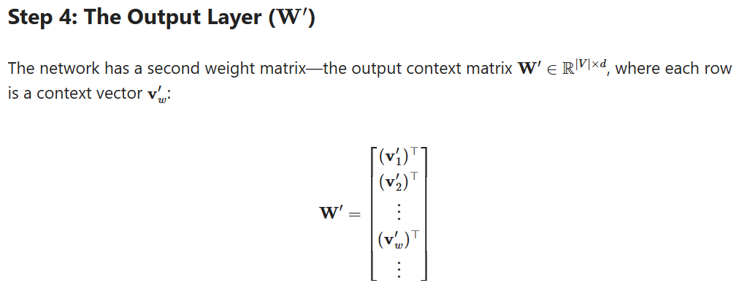
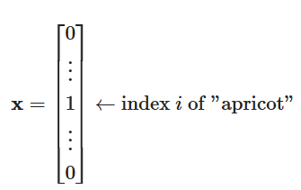




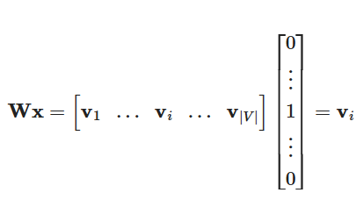













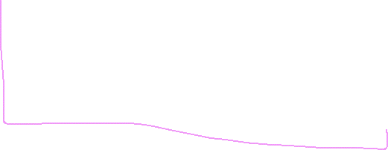
The Embedding Matrix
Arbitrary word w’

Slide 14
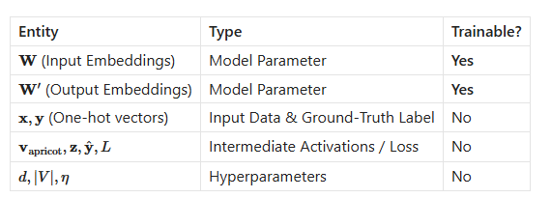
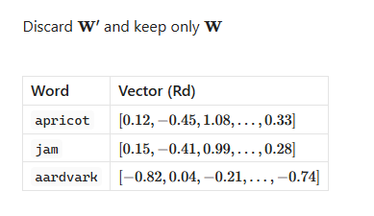
After training:

Slide 15
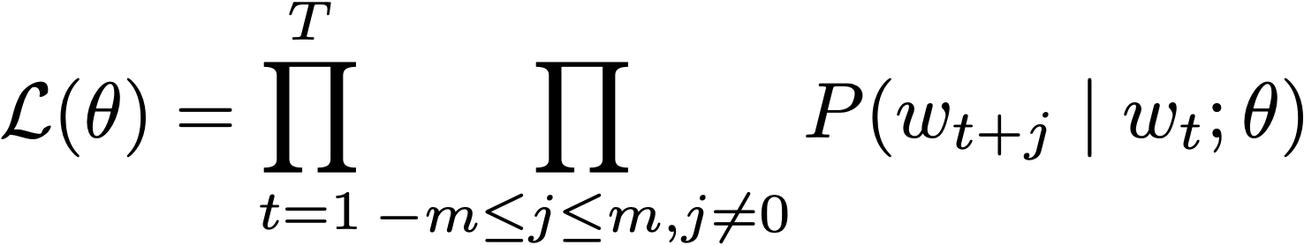
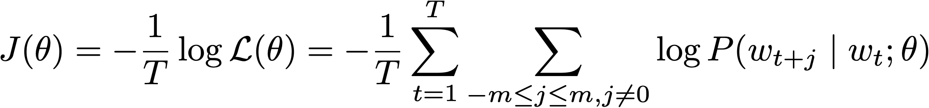
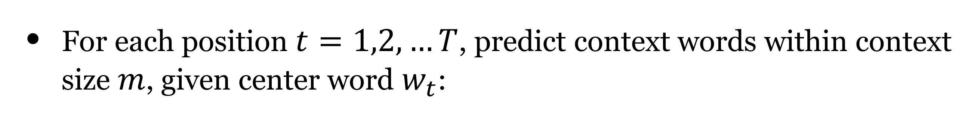
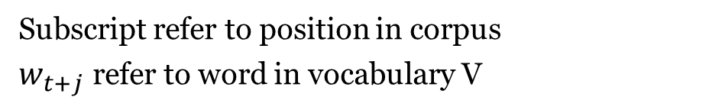
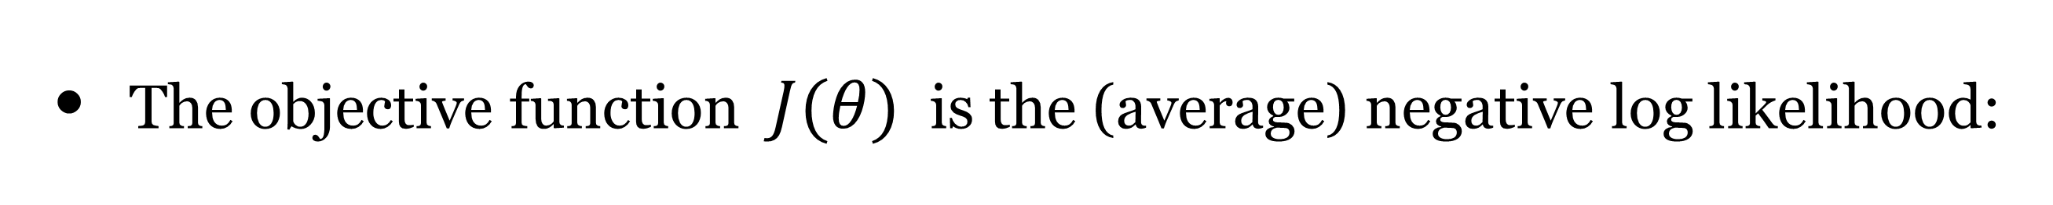
Skip-gram: objective function
For each position $t=1,2,…T$, predict context words within context size $m$, given center word $w_{t}$:
all the parameters to be optimized
Subscript refer to position in corpus
$w_{t+j}$ refer to word in vocabulary V
The objective function $J(θ)$ is the (average) negative log likelihood:
Notes:
Note: slow down and explain notation

Slide 16
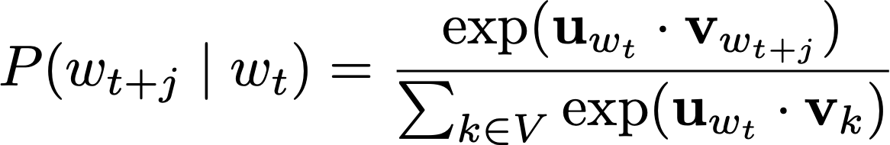

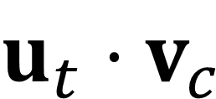
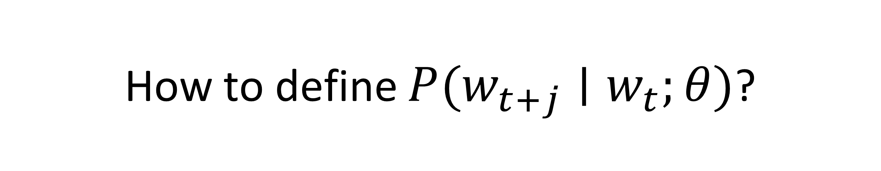
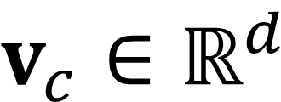
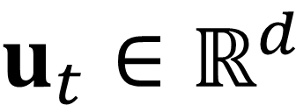
How to define $P(w_{t+j}∣w_{t};θ)$?
  We have two sets of vectors for each word in the vocabulary
$$u_{t}∈ℝ^{d}$$
: embedding for target word t
$$v_{c}∈ℝ^{d}$$
: embedding for context word c
$$u_{t}⋅v_{c}$$
  Use inner product to measure how likely word t appears with context word c, the larger the better
“softmax” we learned before!
Normalized over entire vocabulary
  are all the parameters in this model!
Q: Why two sets of vectors?
Notes:
Q: how many parameters are there in this model?
Q: Why do we need two sets of vectors?

Slide 17
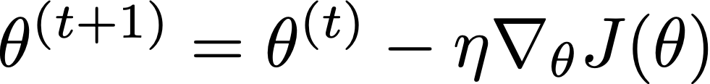

How to train the model
  Objective function: average log likelihood
  Parameters:
Q: How many parameters are in total?
Note: because we need to learn both set of parameters, this is a non-convex objective function
  We can apply stochastic gradient descent (SGD)!
  Need to compute:

Slide 18

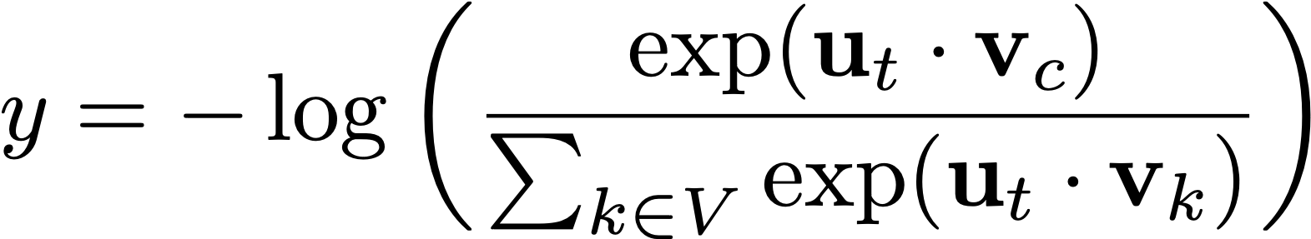
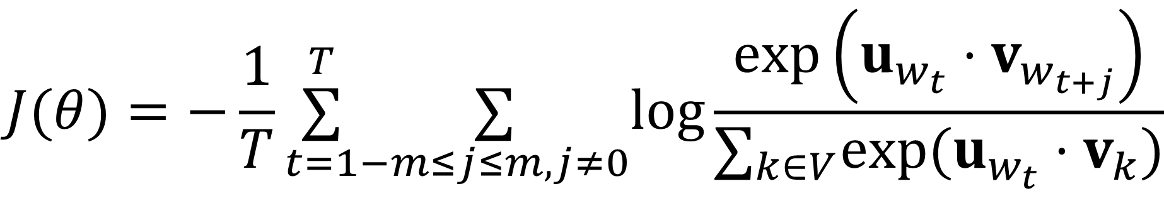
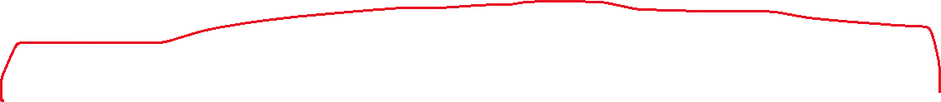

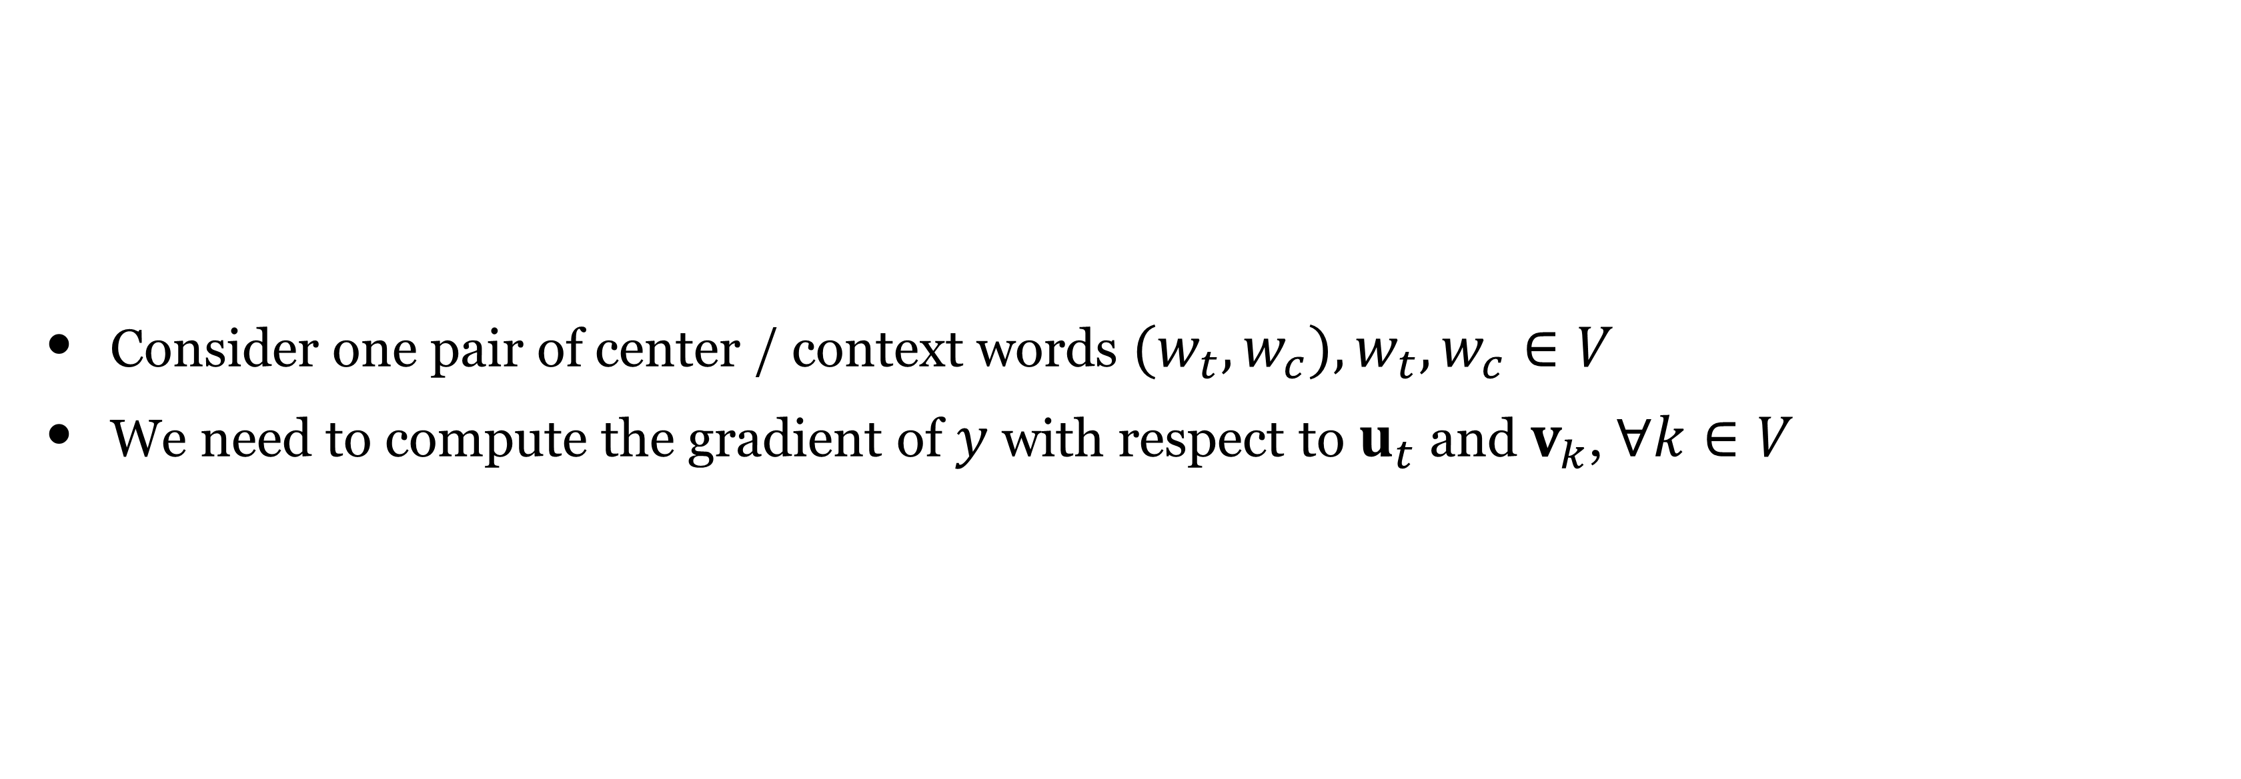


Gradients for word2vec
$$J(θ)=−\frac{1}{T}\overset{T}{\underset{t=1}{∑}}\underset{−m≤j≤m,j≠0}{∑}log\frac{exp\left(u_{w_{t}}⋅v_{w_{t+j}}\right)}{∑_{k∈V}exp(u_{w_{t}}⋅v_{k})}$$
Consider one pair of center / context words $(w_{t},w_{c}),w_{t},w_{c}∈V$
We need to compute the gradient of $y$ with respect to $u_{t}$ and $v_{k}$, $∀k∈V$
Recall P13:

Slide 19
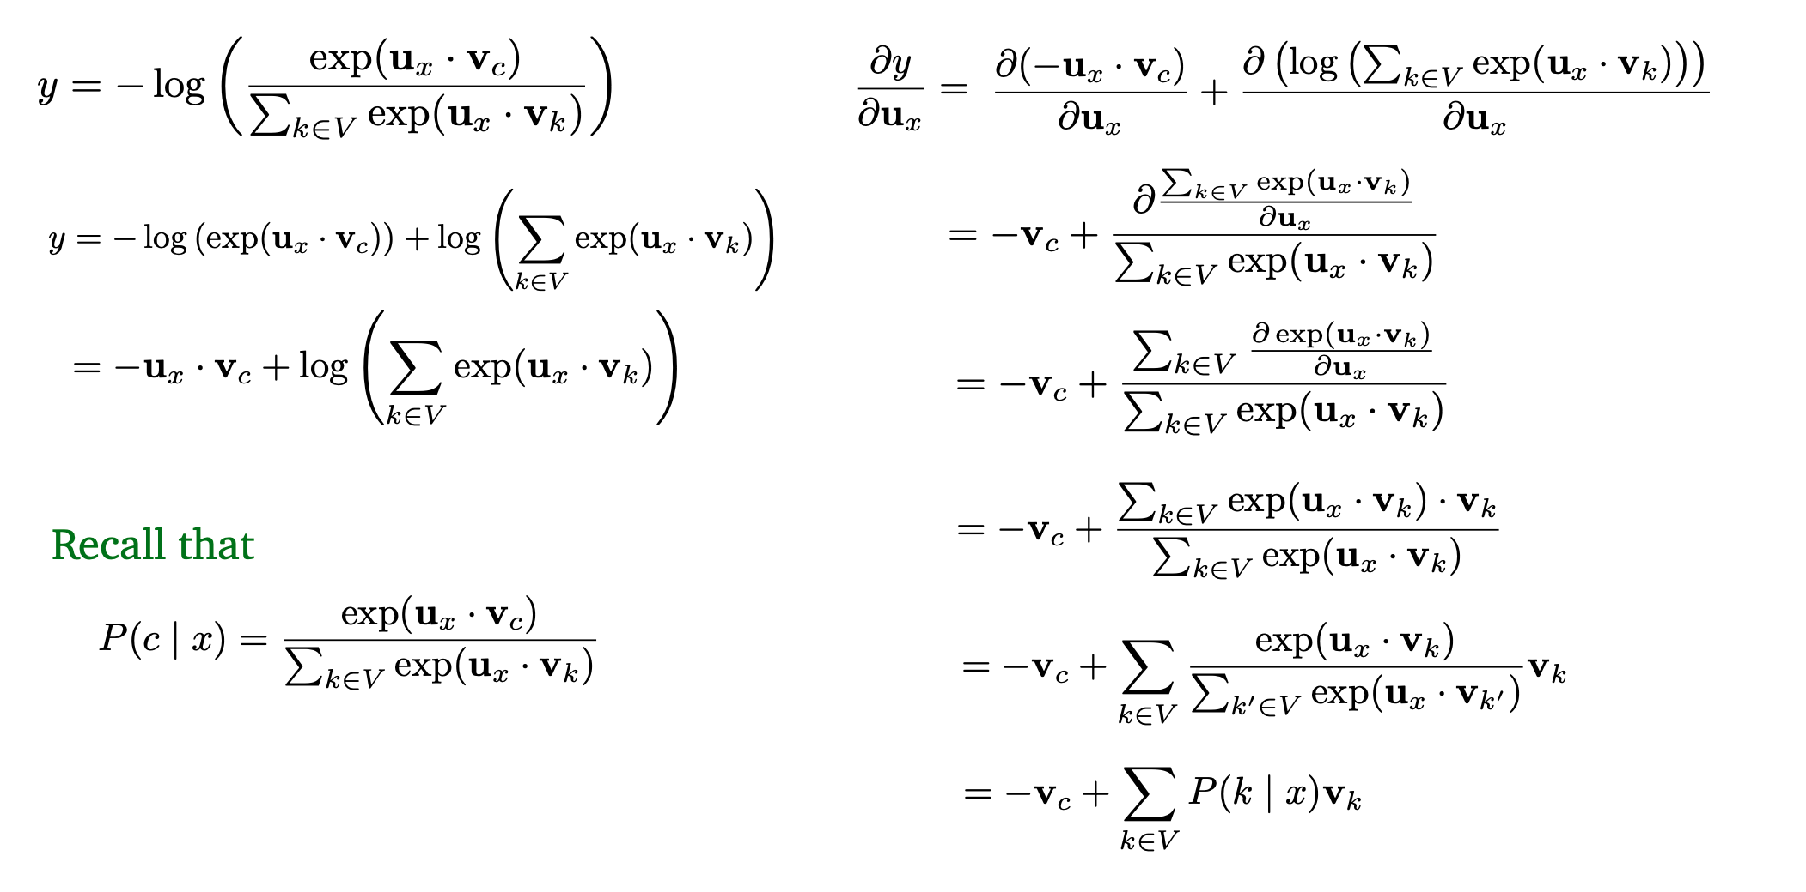

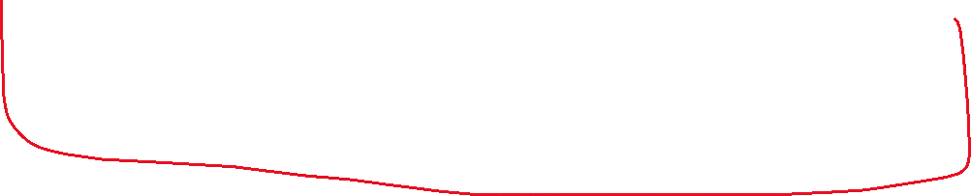


Gradients for word2vec
Replace the c with k

Slide 20
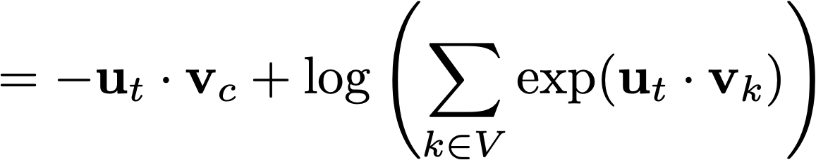

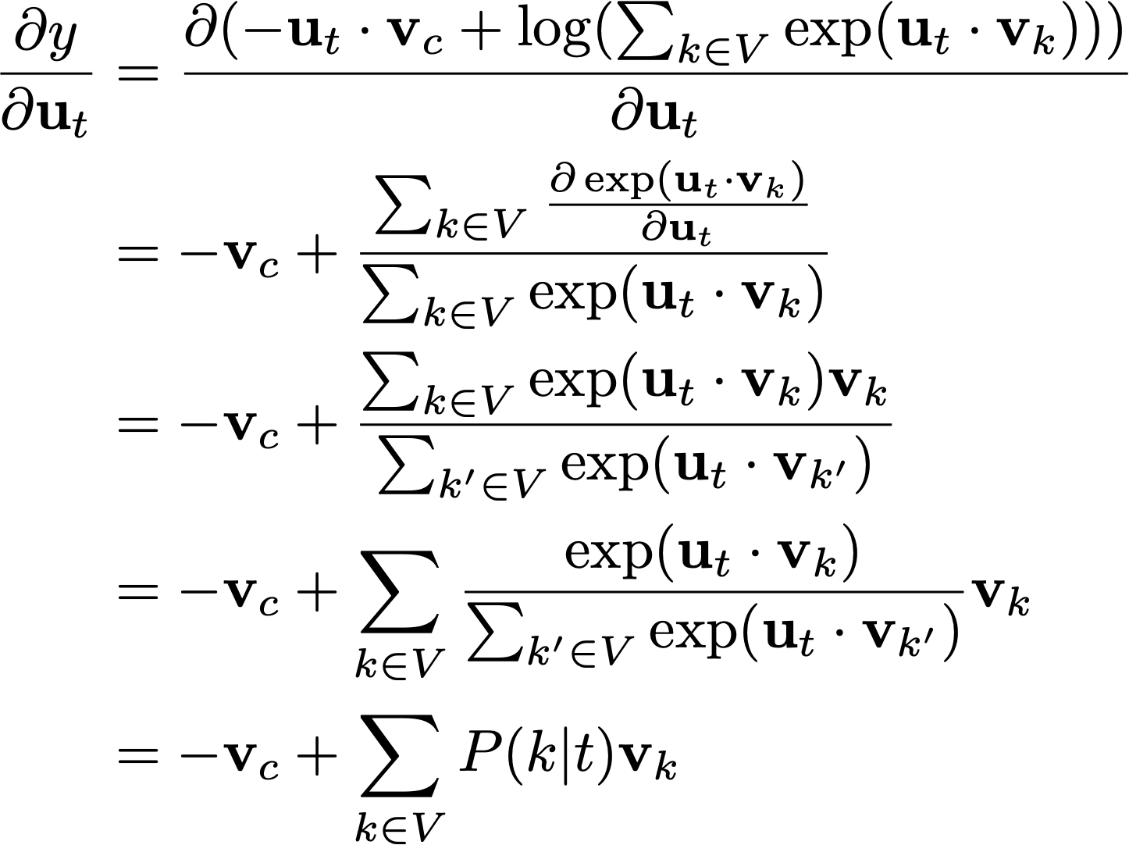
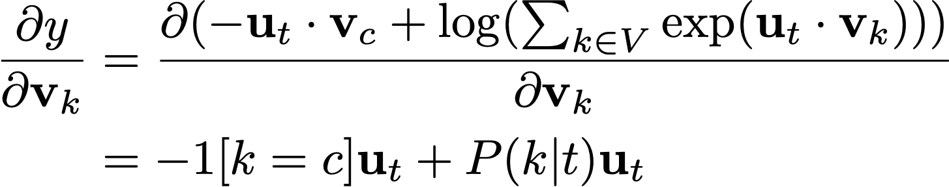
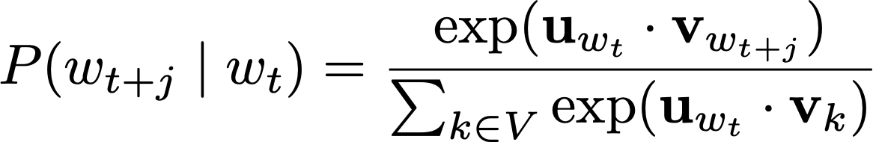


Computing the gradients
  Consider one pair of target/context words (t, c):
Replace the x from last page, with the t
in this page
Note we defined
Make sure you know how to do this!

Slide 21
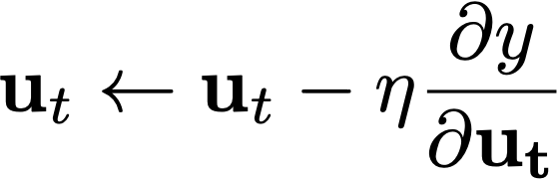
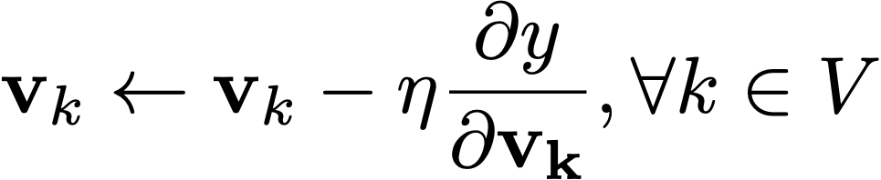
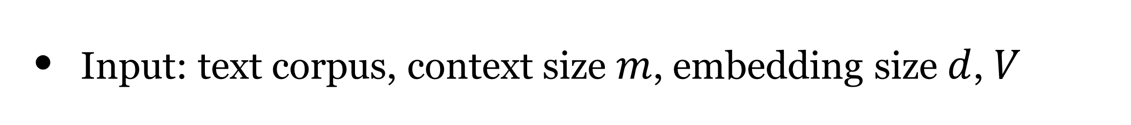

Putting it together
Input: text corpus, context size $m$, embedding size $d$, $V$
Initialize $u_{t},v_{k}$ randomly
Walk through the training corpus and collect training data (t, c):
Update
Update
Any issues?
Notes:
Expensive to compute - over the entire vocabulary

Slide 22
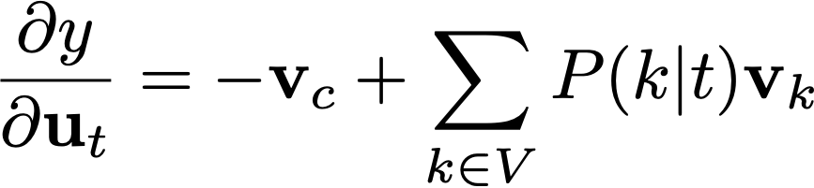
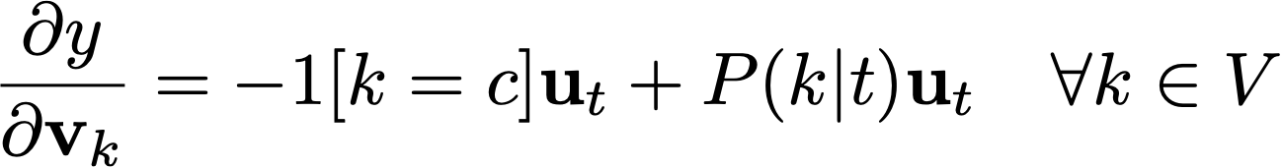
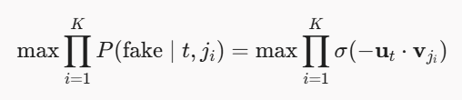
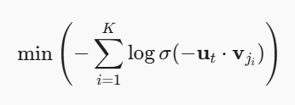













Problem with Naive softmax
Problem: every time you get one pair of (t, c), you need to update $u_{t}$ for each $v_{k}$, and update $v_{k}$ for all the words in the vocabulary! It is very computationally expensive.
Maximize the prob to
recognize it as fake
Negative sampling: instead of considering all the words in V, let’s randomly sample K (5-20) negative examples.
softmax:
Fake context word
NS:
Q: how does it solve this problem of the cost?
Notes:
Cost per Step
$\mathcal{O}(\vert{}V\vert{} \cdot d)$
$\mathcal{O}(K \cdot d)$

Slide 23



Monte Carlo Approximation
Draw the wrong word K times randomly

Slide 24





Skip-gram with negative sampling (SGNS)
Key idea: convert the |V|-way classification problem into a binary classification problem
Every time we get a pair of (t,c) words, predict if they co-occur together or not.
(don’t try to predict the correct c from amongst all the words in the vocabulary)
Similar to training a logistic regression for binary classification (but need to optimize u and v together)
http://jalammar.github.io/illustrated-word2vec/
Notes:
Question: Number of parameters that is updated every step? (K+1) v vectors and 1 u vector = (K+2)d updates
d = dimension of the

Slide 25
Skip-gram with negative sampling (SGNS)
Basic formula:
1. Treat the target word and a neighboring context word as positive examples.
2. Randomly sample other words in the lexicon to get negative samples
3. Train a classifier to distinguish those two cases
4. Use the weights as the embeddings

Slide 26


SimCLR: A Simple Framework for Contrastive Learning
Source: Chen et al., 2020

Slide 27
SGNS: Training the classifier
Iterative process
Let's represent words as vectors of some length (say 300), randomly initialized.
  So we start with 300 * V random parameters
Over the entire training set, adjust those word vectors
Maximize the similarity of the target word, context word pairs (t,c) drawn from the positive data
Minimize the similarity of the (t,c) pairs drawn from the negative data.
Notes:
Then adjust the word weights to
make the positive pairs more likely
and the negative pairs less likely
over the entire training set

Slide 28

Skip-gram with negative sampling
Training sentence:
... lemon, a tablespoon of apricot jam a pinch ...
c1 c2 t c3 c4
Training data: input/output pairs centering on apricot
assume a +/- 2 word window
Training data
Given a tuple $(t,c)$ = target, context
  (apricot, jam)
  (apricot, aardvark)
Return probability that $c$ is a real context word:
$P(+|t,c)$
$$P(−|t,c)=1−P(+|t,c)$$
Goal

Slide 29

+ sample
- sample

Slide 30


SGNS Training
Training sentence:
... lemon, a tablespoon of apricot jam a pinch ...
c1 c2 t c3 c4
• For each positive example, we'll create $K$ negative examples.
• Using noise words
• Any random word that isn't $t$

Slide 31



Choosing noise words
Could pick $w$ according to their unigram frequency $P(w)$
More common to chose them according to $P_{α}(w)$
α= ¾ works well because it gives rare noise words slightly higher probability
To show this, imagine two events $p(a)=0.99$ and $p(b)=0.01$:
Notes:
TODO: More details about negative sampling and selection of negatives.

Slide 32

SGNS: objective function
We want to maximize…
Maximize the + label for the pairs from the positive training data,
and the – label for the pairs sample from the negative data.

Slide 33

Focusing on one target word t:

Slide 34




Relationship of PMI and Word2Vec
Word2Vec Skipgram with negative sampling (SGNS) implicitly factorizes word-context PMI matrix
Other differences in factorization
  SGNS factorizes into two unconstrained matrices (vs two orthonormal and one diagonal matrix for SVD)
  The loss used for the factorizing is different
    SVD - Frobenius norm (Euclidean norm / entrywise L2)
    Word2Vec SGNS - weighted logistic loss
$W$ is the matrix of word embeddings
$C$ is the matrix of context embeddings
$k$ is the number of negative samples,
and the samples follows the unigram distribution
[Neural Word Embedding as Implicit Matrix Factorization, Levy and Goldberg, 2014]
[Improving Distributional Similarity with Lessons Learned from Word Embeddings, Levy, Goldberg, and Dagan, 2015]
Notes:
CBOW does not factorize (due to the averaging)

Slide 35




Continuous Bag of Words (CBOW)
Likelihood

Slide 36

Skip-gram vs CBOW
CBOW is comparatively faster to train than skip-grams and better for frequently occurring words
Skip-gram is slower but works well for smaller amount of data and works well for less frequently occurring words
CBOW is a simpler problem than Skip-gram because in CBOW we just need to predict the one center word given many context words

Slide 37




GloVe: Global Vectors
Let’s take the global co-occurrence statistics: $X_{i,j}$
Try to learn word vectors to predict the co-occurrence counts (using L2 loss)
Function f to weight loss by frequency of words (from 0 to 1)
Final word vector:
Training faster
Scalable to very large corpora
(Pennington et al, 2014): GloVe: Global Vectors for Word Representation

Slide 38










Target value

Slide 39

GloVe: Global Vectors
(Pennington et al, 2014): GloVe: Global Vectors for Word Representation

Slide 40


FastText: Sub-Word Embeddings
Similar as Skip-gram, but break words into n-grams with n = 3 to 6
  where:
  3-grams: <wh, whe, her, ere, re>
  4-grams: <whe, wher, here, ere>
  5-grams: <wher, where, here>
  6-grams: <where, where>
Note: All the embeddings that we have learned are also called “static word embeddings”: there is one fixed vector for every word in the vocabulary.
Replace by
More to come! Contextualized word embeddings
(Bojanowski et al, 2017): Enriching Word Vectors with Subword Information

Slide 41

Trained word embeddings available
word2vec: https://code.google.com/archive/p/word2vec/
GloVe: https://nlp.stanford.edu/projects/glove/
FastText: https://fasttext.cc/
Differ in algorithms, text corpora, dimensions, cased/uncased…

Slide 42
Evaluating Word Embeddings

Slide 43





Extrinsic vs intrinsic evaluation
👎
Extrinsic evaluation
  Let’s plug these word embeddings into a real NLP system and see whether this improves performance
  Could take a long time but still the most important evaluation metric
ML model
$$\left(\begin{aligned}0.31 \\ −0.28\end{aligned}\right)$$
$$\left(\begin{aligned}0.01 \\ −0.91\end{aligned}\right)$$
$$\left(\begin{aligned}1.87 \\ 0.03\end{aligned}\right)$$
$$\left(\begin{aligned}−3.17 \\ −0.18\end{aligned}\right)$$
$$\left(\begin{aligned}1.23 \\ 1.59\end{aligned}\right)$$
I
don’t
like
this
movie
Intrinsic evaluation
  Evaluate on a specific/intermediate subtask
  Fast to compute
  Not clear if it really helps the downstream task

Slide 44






Intrinsic evaluation
Word similarity
Example dataset: wordsim-353
353 pairs of words with human judgement
http://www.cs.technion.ac.il/~gabr/resources/data/wordsim353/
Cosine similarity:
$$cos(u_{i},u_{j})=\frac{u_{i}⋅u_{j}}{∥u_{i}∥_{2}×∥u_{j}∥_{2}}$$
Metric: Spearman rank correlation
covariance
$$r_{s}=ρ_{R(X),R(Y)}=\frac{\text{cov}(R(X),R(Y))}{σ_{R(X)}σ_{R(Y)}}$$
squared deviation
Notes:
Spearman rank correlation - Pearson correlation between the ranks

Slide 45

Spearman rank correlation
$$r_{s}=ρ_{R(X),R(Y)}=\frac{\text{cov}(R(X),R(Y))}{σ_{R(X)}σ_{R(Y)}}$$
Between -1 and +1
Negative correlation
Positive correlation
Notes:
https://en.wikipedia.org/wiki/Spearman%27s_rank_correlation_coefficient

Slide 46

Intrinsic evaluation
Word Similarity
Spearman rank correlation of word vector similarities with different human judgements on different datasets
All vectors are 300-dimensional
(Pennington et al, 2014): GloVe: Global Vectors for Word Representation
Notes:
Correlations of word vector similarities using different embedding techniques with
different human judgment datasets
CBOW models contain phrases

Slide 47

Analogy: Embeddings capture relational meaning!
Intrinsic evaluation
Word analogy
(slide credit: Stanford CS124, Dan Jurafsky)
Notes:
Word Analogy Reasoning / Test：词类比推理 / 词类比测试

Slide 48





Intrinsic evaluation
syntactic
semantic
Word analogy
man: woman $≈$ king: ?
semantic
syntactic
Chicago:Illinois$≈$Philadelphia: ?
bad:worst $≈$ cool: ?
More examples at
http://download.tensorflow.org/data/questions-words.txt
Notes:
Semantic（语义关系） Syntactic（句法/形态关系）

Slide 49

Hyperparameters and settings matter
Word Similarity
Analogies
[Improving Distributional Similarity with Lessons Learned from Word Embeddings, Levy, Goldberg, and Dagan, 2015]

Slide 50








Embeddings can help study word history!
so we can plot
Train embeddings on old books to study changes in word meaning
(slide credit: Stanford CS124, Dan Jurafsky)

Slide 51

Fairness learning: Bias in word embeddings
Embeddings reflect cultural bias
Biases change over time
(slide credit: Stanford CS124, Dan Jurafsky)

Slide 52
Using word embeddings to study bias
From the historical embeddings for each decade
1. Compute historical biases of each word:
  Gender bias: how much closer a word is to "woman" synonyms than "man" synonyms.
  Chinese bias: how much closer a word (engineer, math, science) is to Chinese names (Wang, Yang, Chen) than Anglo names.
2. Correlate with occupational data from historical census
3. Look at how all these change over time
Word embeddings quantify 100 years of gender and ethnic stereotypes, Garg et al, 2018
(slide credit: Stanford CS124, Dan Jurafsky)

Slide 53



Embedding bias correlates with actual occupation data
Word embeddings quantify 100 years of gender and ethnic stereotypes, Garg et al, 2018
(slide credit: Stanford CS124, Dan Jurafsky)

Slide 54





Embeddings reflects gender bias in occupations across time (1910-1990)
(slide credit: Stanford CS124, Dan Jurafsky)

Slide 55
Embeddings reflect ethnic stereotypes over time
Princeton trilogy experiments
Attitudes toward ethnic groups (1933, 1951, 1969) scores for adjectives
  industrious, superstitious, nationalistic, etc
Cosine of Chinese name embeddings with those adjective embeddings correlates with human ratings.

Slide 56
Impact: imagine an interviewer uses LLMs to filter your job application.
Unfair to Asians, Africans, Indigenous people, and other minorities.

Slide 57


Asian bias over time
(slide credit: Stanford CS124, Dan Jurafsky)

Slide 58

Asian bias over time
(slide credit: Stanford CS124, Dan Jurafsky)

Slide 59
Beyond Simple Word Embeddings

Slide 60

Extensions to word vectors
Subword embeddings (FastText)
Phrases and multi-word expressions
Sense embeddings
Embeddings using other types of context, spaces (use a document as a context)
Cross-lingual and cross-modal embeddings
Context dependent embeddings (Elmo, BERT)

Slide 61









Simple sentence embeddings
from word embeddings
Take average
Take weighted average
Weight rare words more
Shift sentence embedding
Let $V_{s}$ be matrix whose columns are the sentence vectors $v_{s}$, and $u$ be the first singular vector of $V_{s}$
Basic idea: try to subtract out vector corresponding to syntax
(assume it is vector associated with first singular value)
All these are BOW models
Later we will look at models (RNNs) that take order into account.
[A simple but tough-to-beat baseline for sentence embeddings, Arora, Liang and Ma, 2017]

Slide 62

Sense Embeddings
Sense Embeddings
Improving Word Representations via Global Context and Multiple Word Prototypes [Huang et al, 2012]
Notes:
Jaguar /ˈdʒæɡˌwɑːr/

Slide 63


Beyond Euclidean spaces
Tree with equally spaced nodes
Hyperbolic (Poincare) embeddings
Distances grow exponentially as points go toward the boundary
better for hierarchically organized elements
Poincaré Embeddings for Learning Hierarchical Representations [Nickel and Kiela, 2017]

Slide 64
Cross-lingual word embeddings
See https://ruder.io/cross-lingual-embeddings/
Bilingual Word Representations with Monolingual Quality in Mind
[Luong et al, 2015]

Slide 65

Cross-modal embeddings
grounding language in visual perception
Pairing word vectors with images, Contrastive similarity alignment
Unifying Visual-Semantic Embeddings with Multimodal Neural Language Models
[Kiros, Salakhutdinov, and Zemel, TACL 2015]

Slide 66
Summary
Word embeddings can be learned using Word2Vec and GloVe
You can also use SVD on PPMI co-occurrence matrix to obtain dense word vectors
There is connection between Word2Vec and PPMI co-occurrence matrix
Evaluating embeddings
Bias in embeddings
Some ways to extend embeddings

